Slide 1
CoNiO Potential
Using MgNiO at first, but substitute Mg with Ni

Slide 2
Final Run to Report

Slide 3
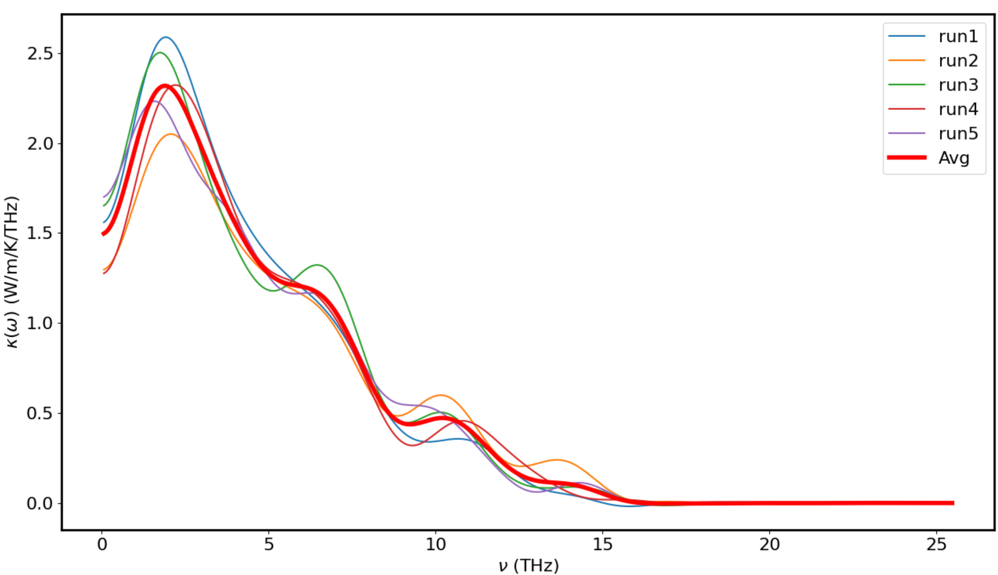
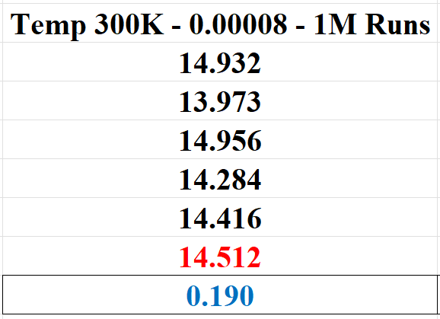
CoNiO - 300K – 0.00008 – 10M Runs

Slide 4
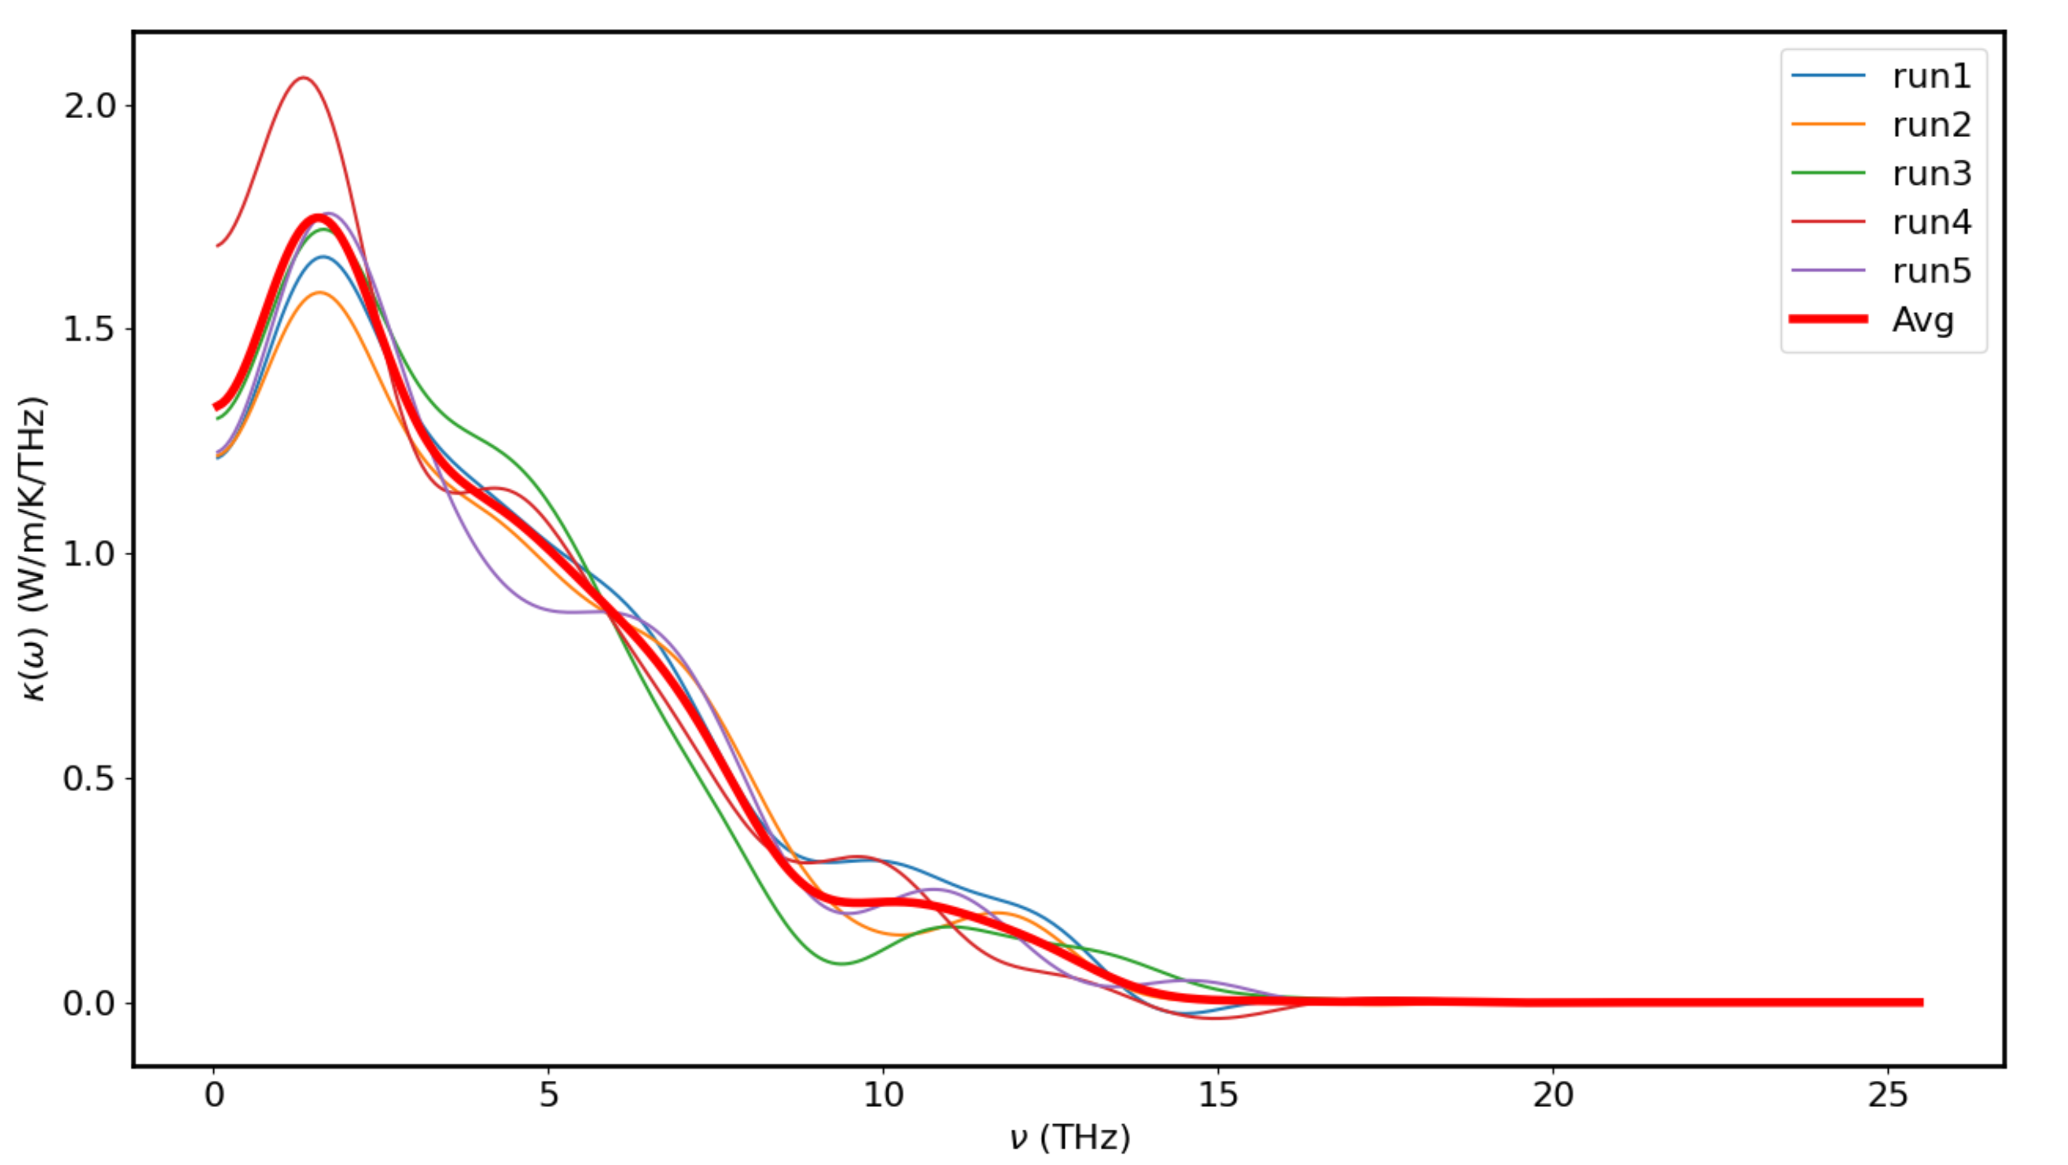
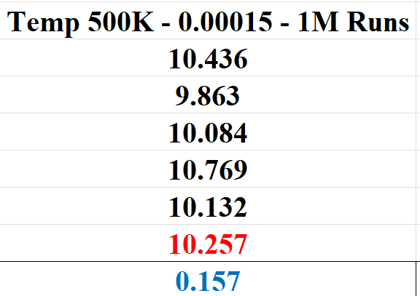
CoNiO - 500K – 0.00015 – 10M

Slide 5
Additional Experimental Runs

Slide 6
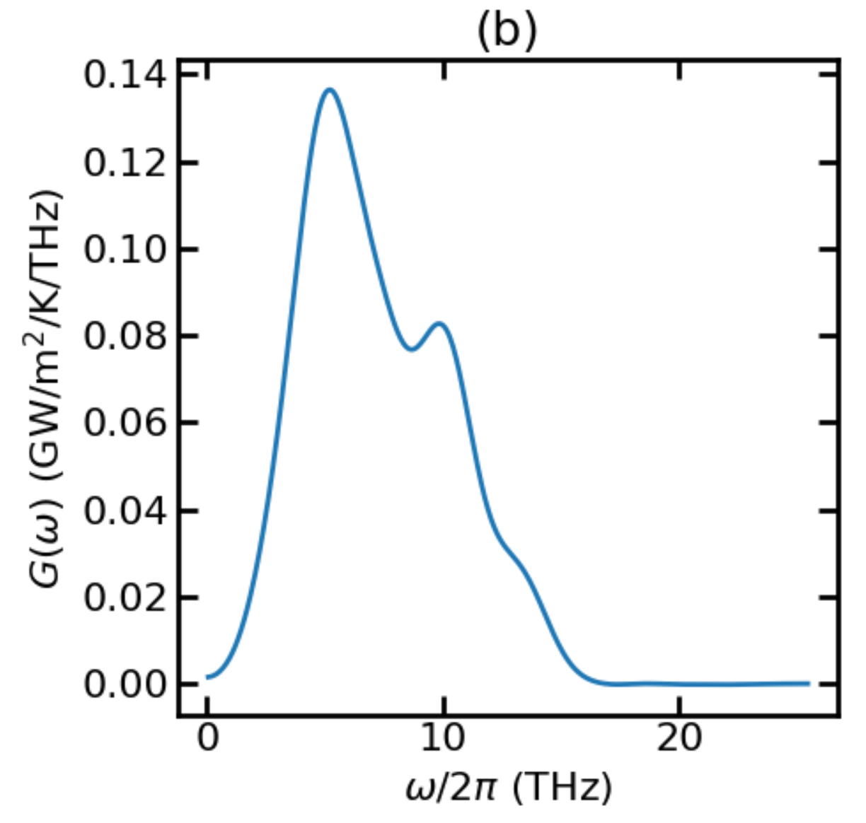
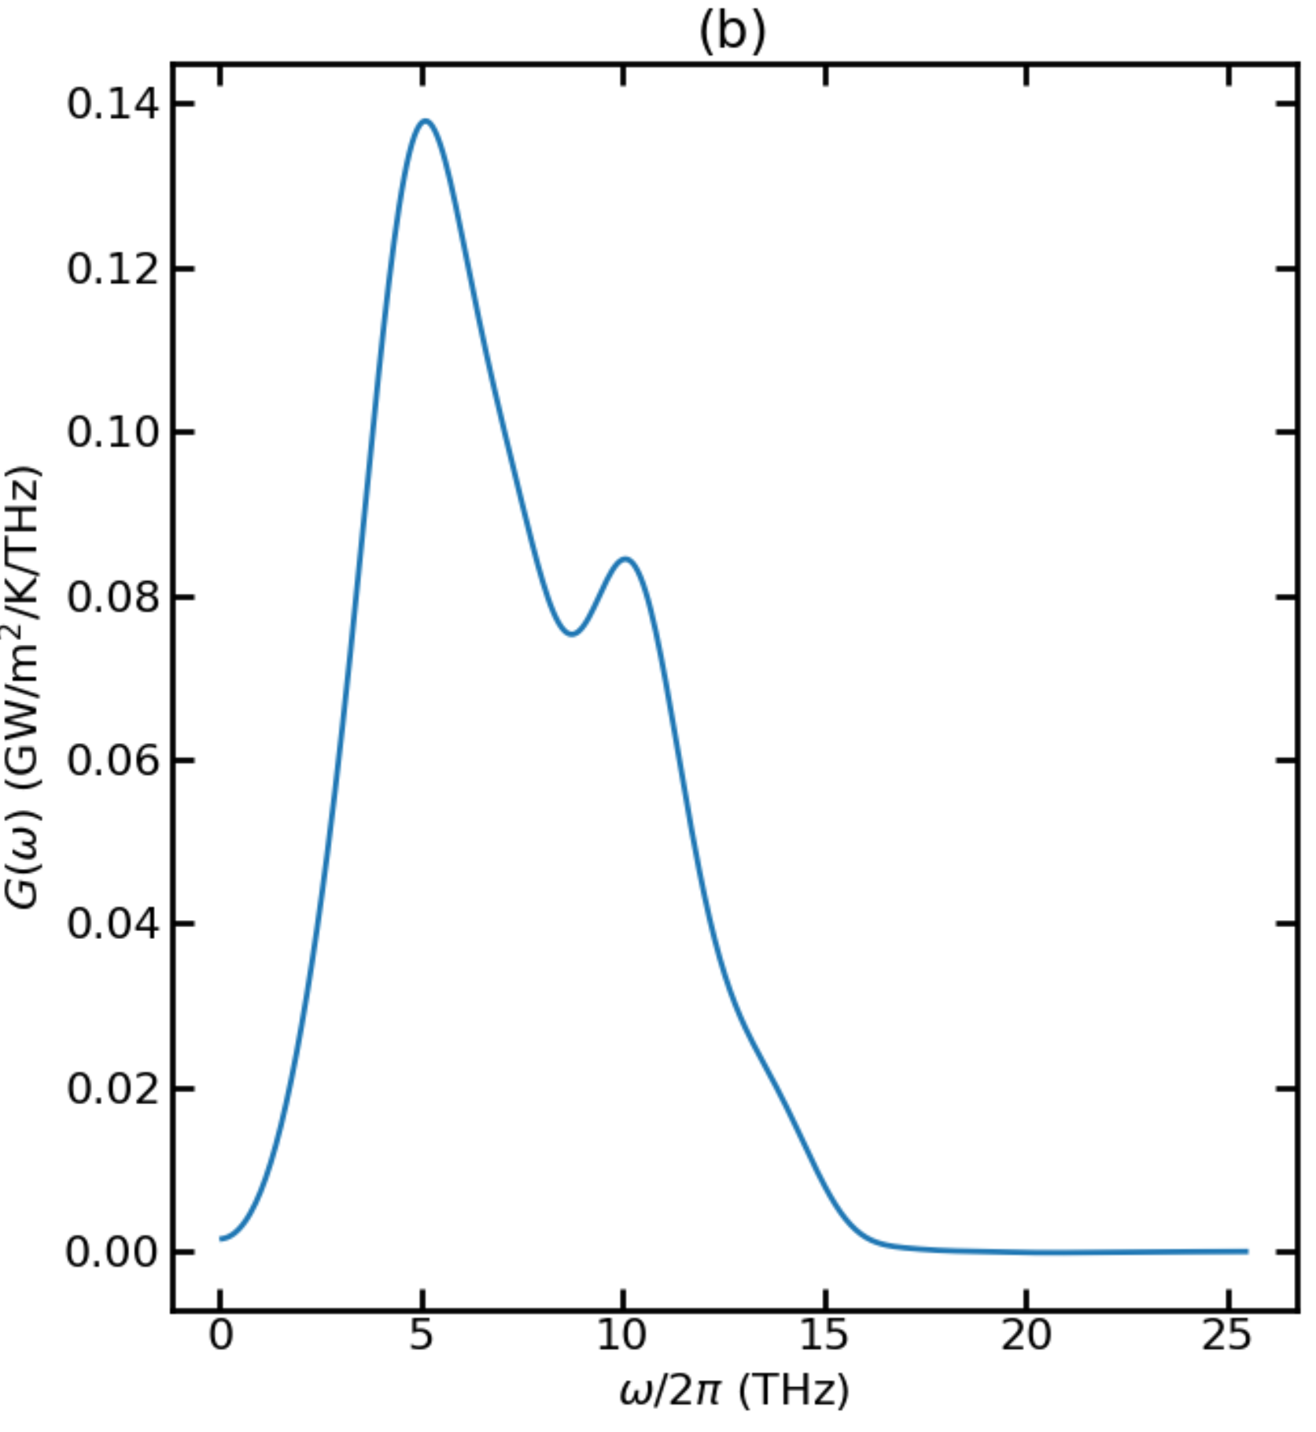
CoNiO - 300K - ballistic

Slide 7
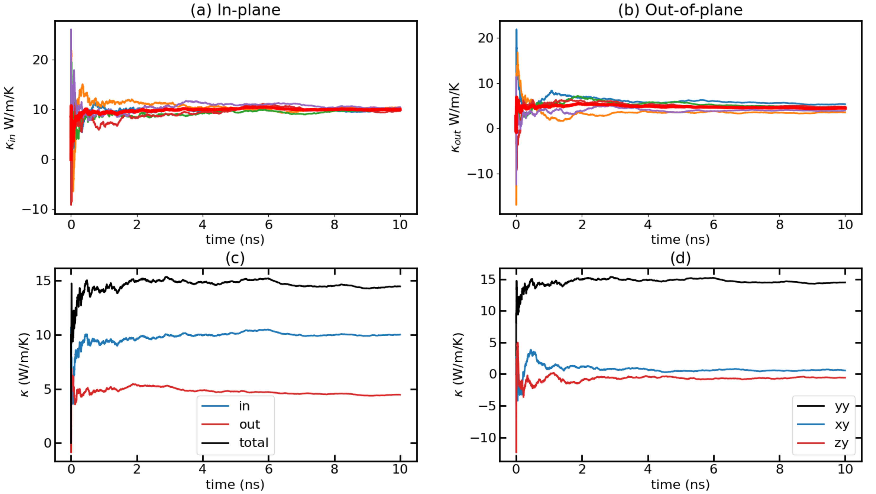
CoNiO - 300K – 0.00008 – 10M Runs

Slide 8
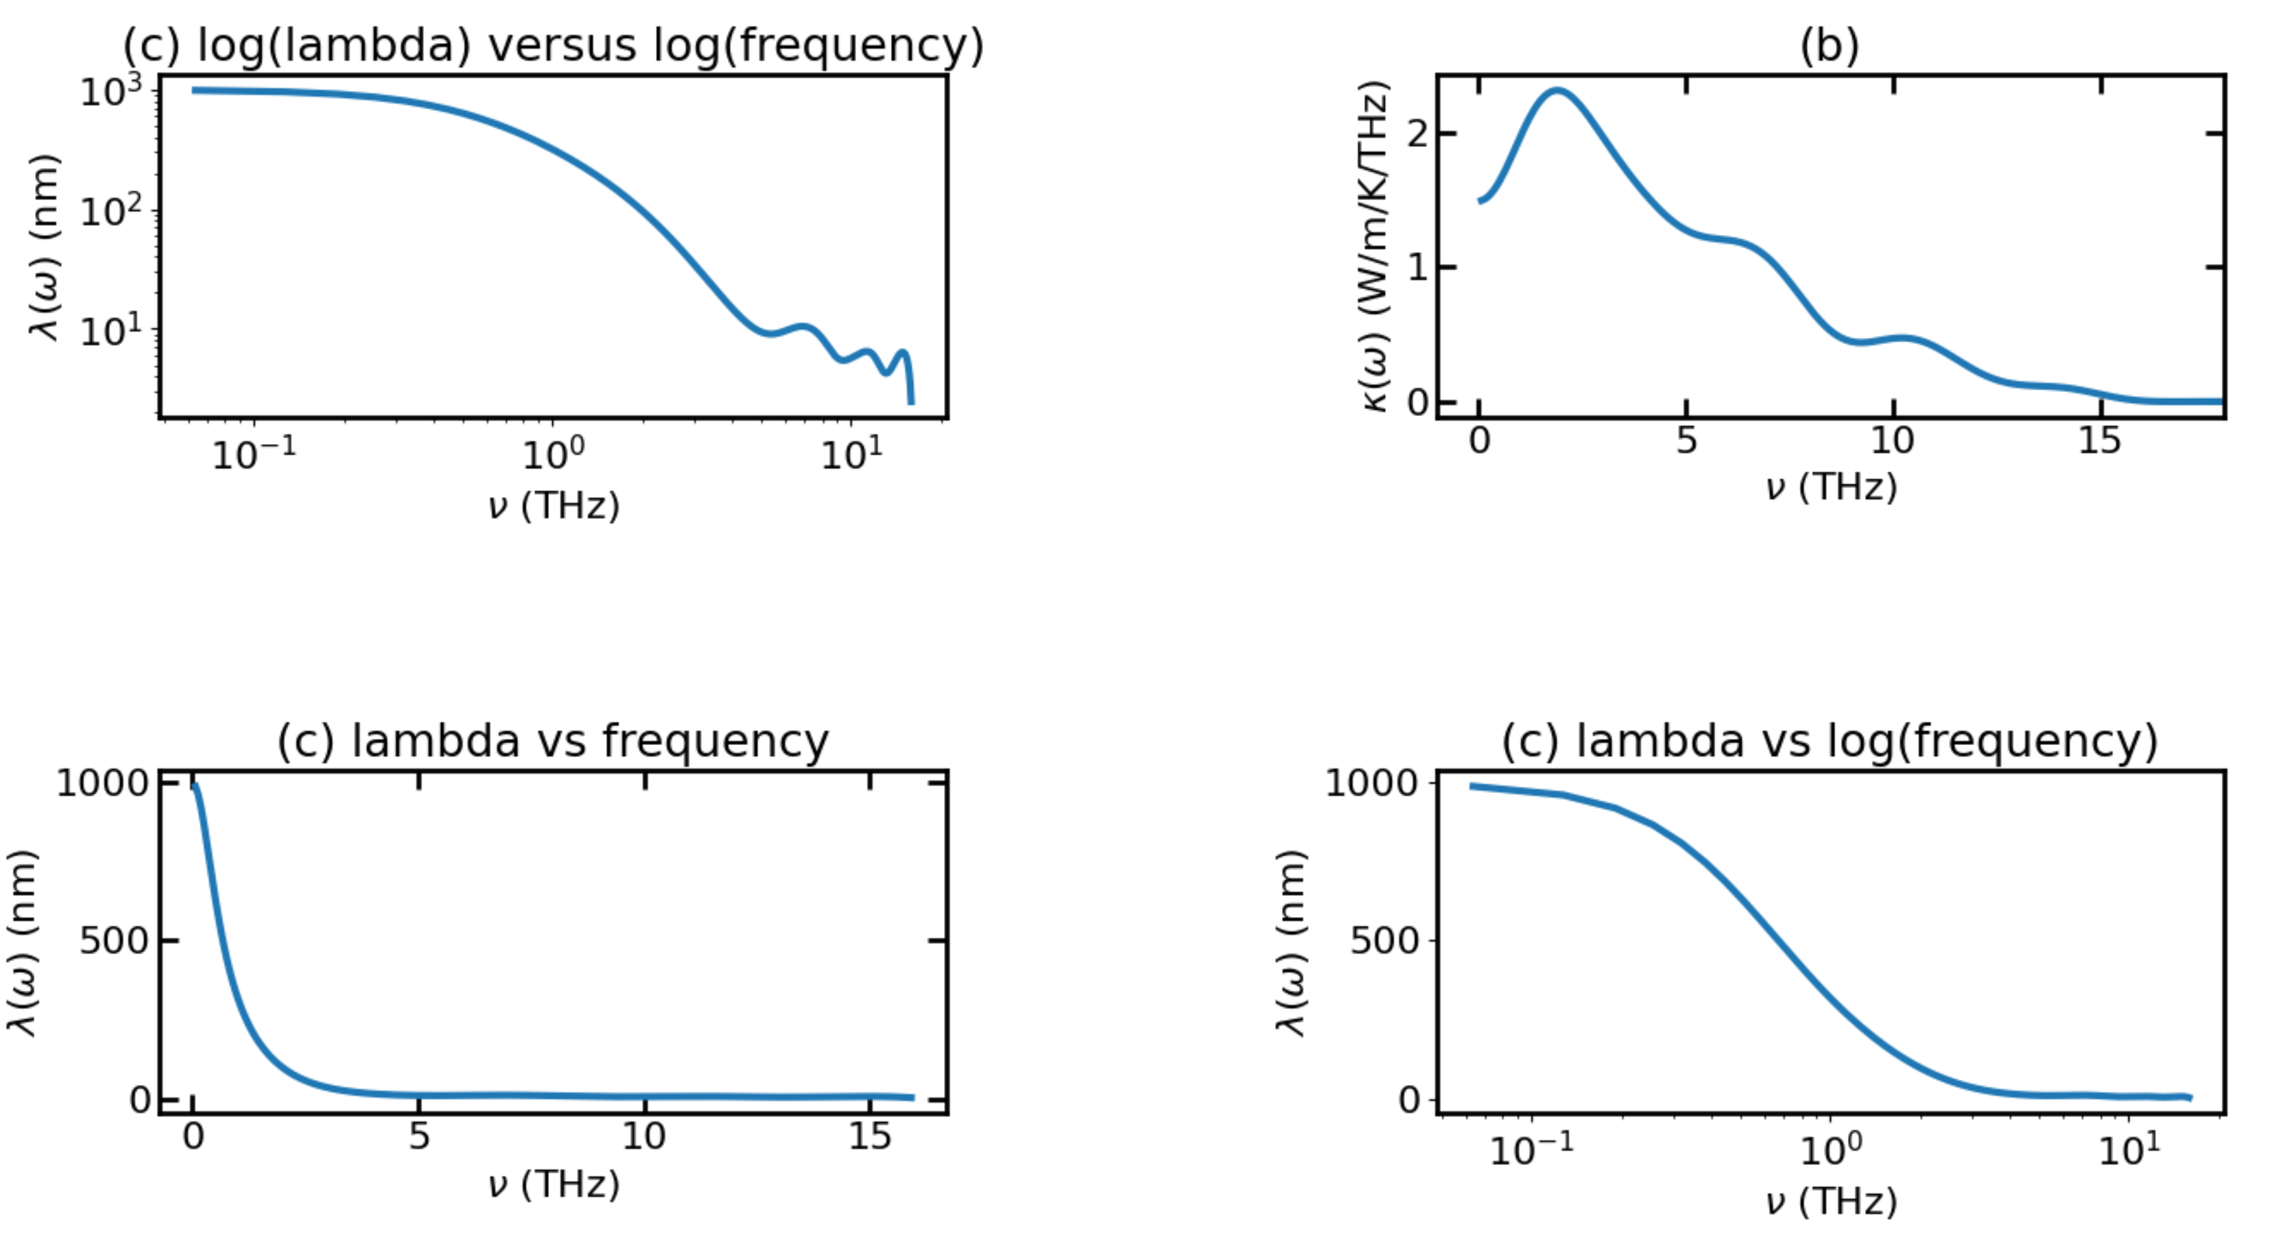
CoNiO - 300K – 0.00008 – 10M Runs

Slide 9
CoNiO - 300K – 0.00008 – 10M Runs

Slide 10
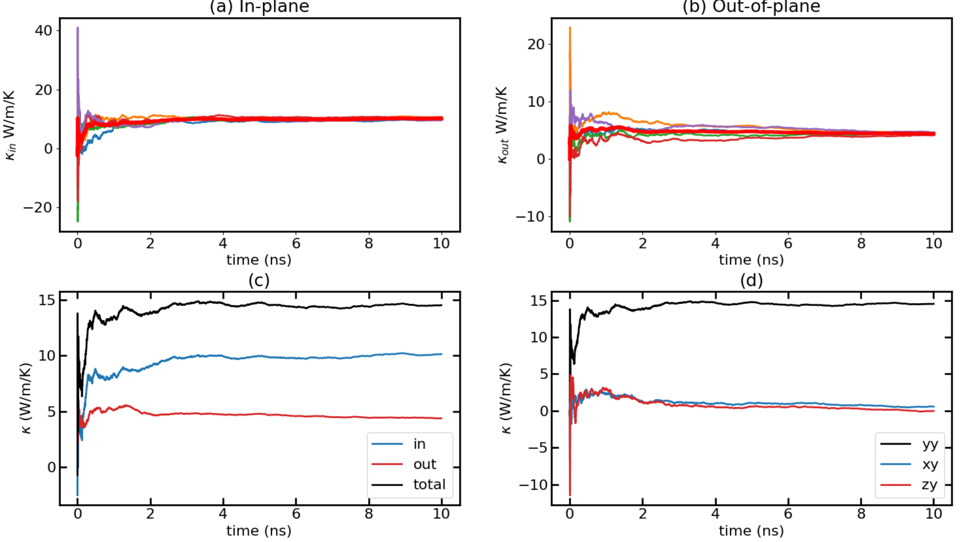
CoNiO - 300K – 0.00009 – 10M Runs

Slide 11
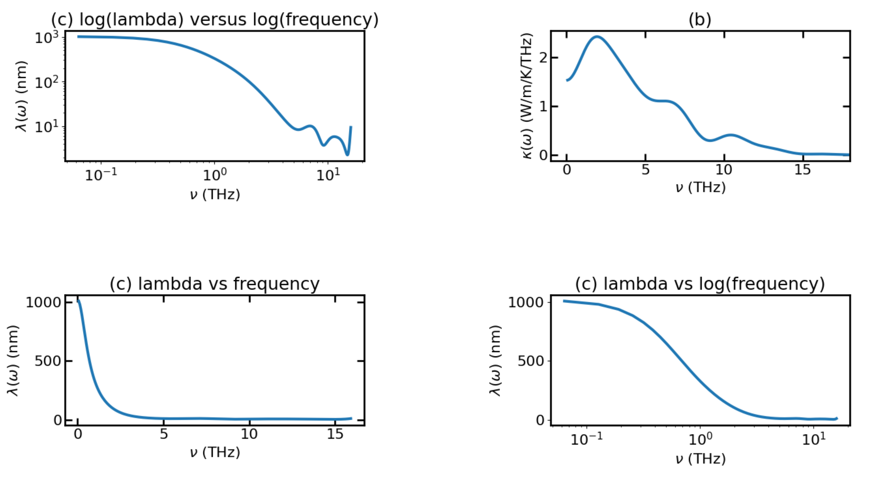
CoNiO - 300K – 0.00009 – 10M Runs

Slide 12
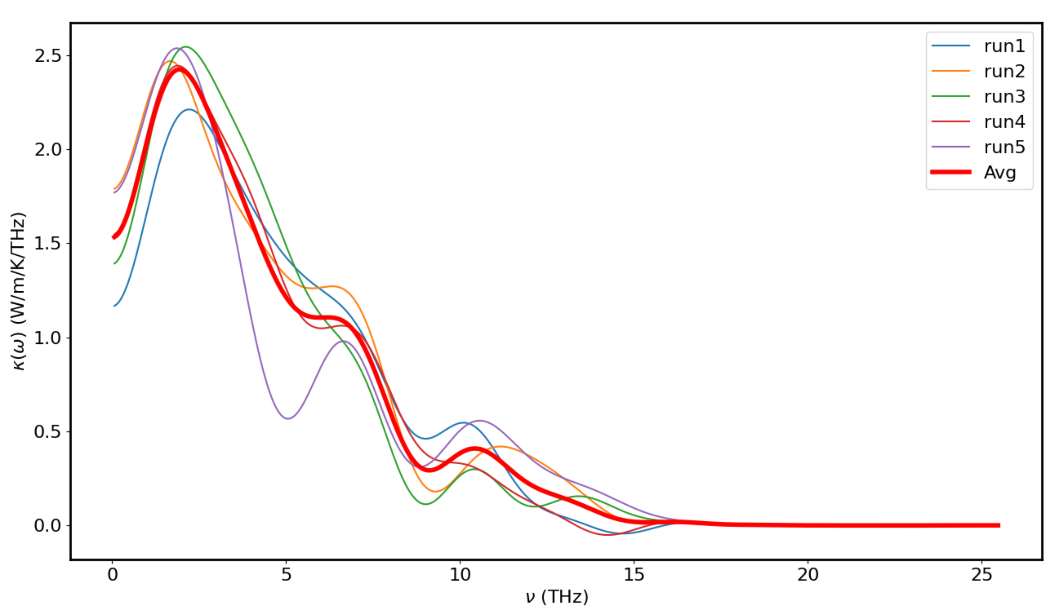
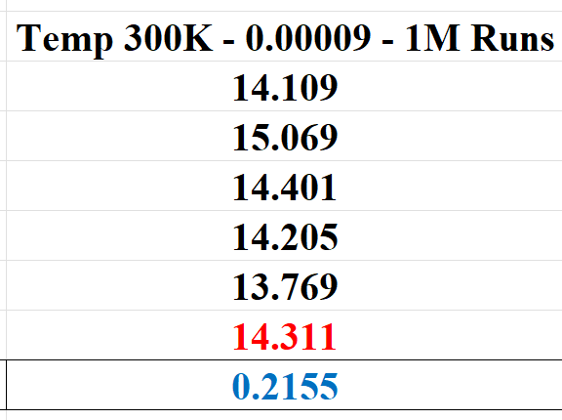
CoNiO - 300K – 0.00009 – 10M Runs

Slide 13
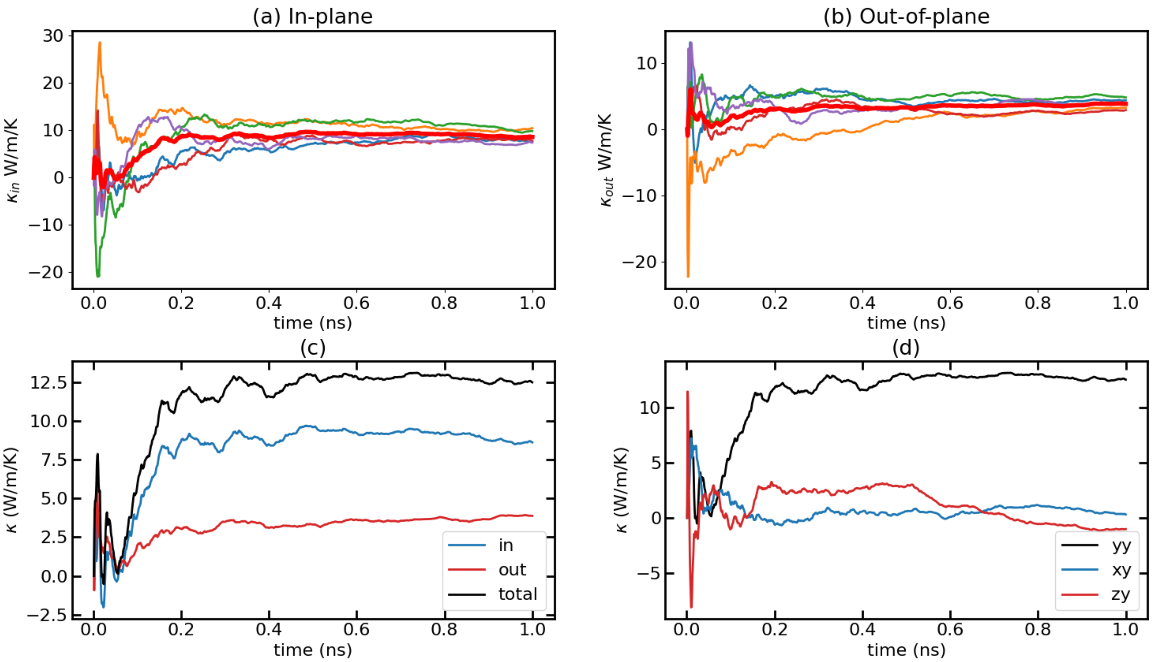
CoNiO - 300K – 0.0001

Slide 14
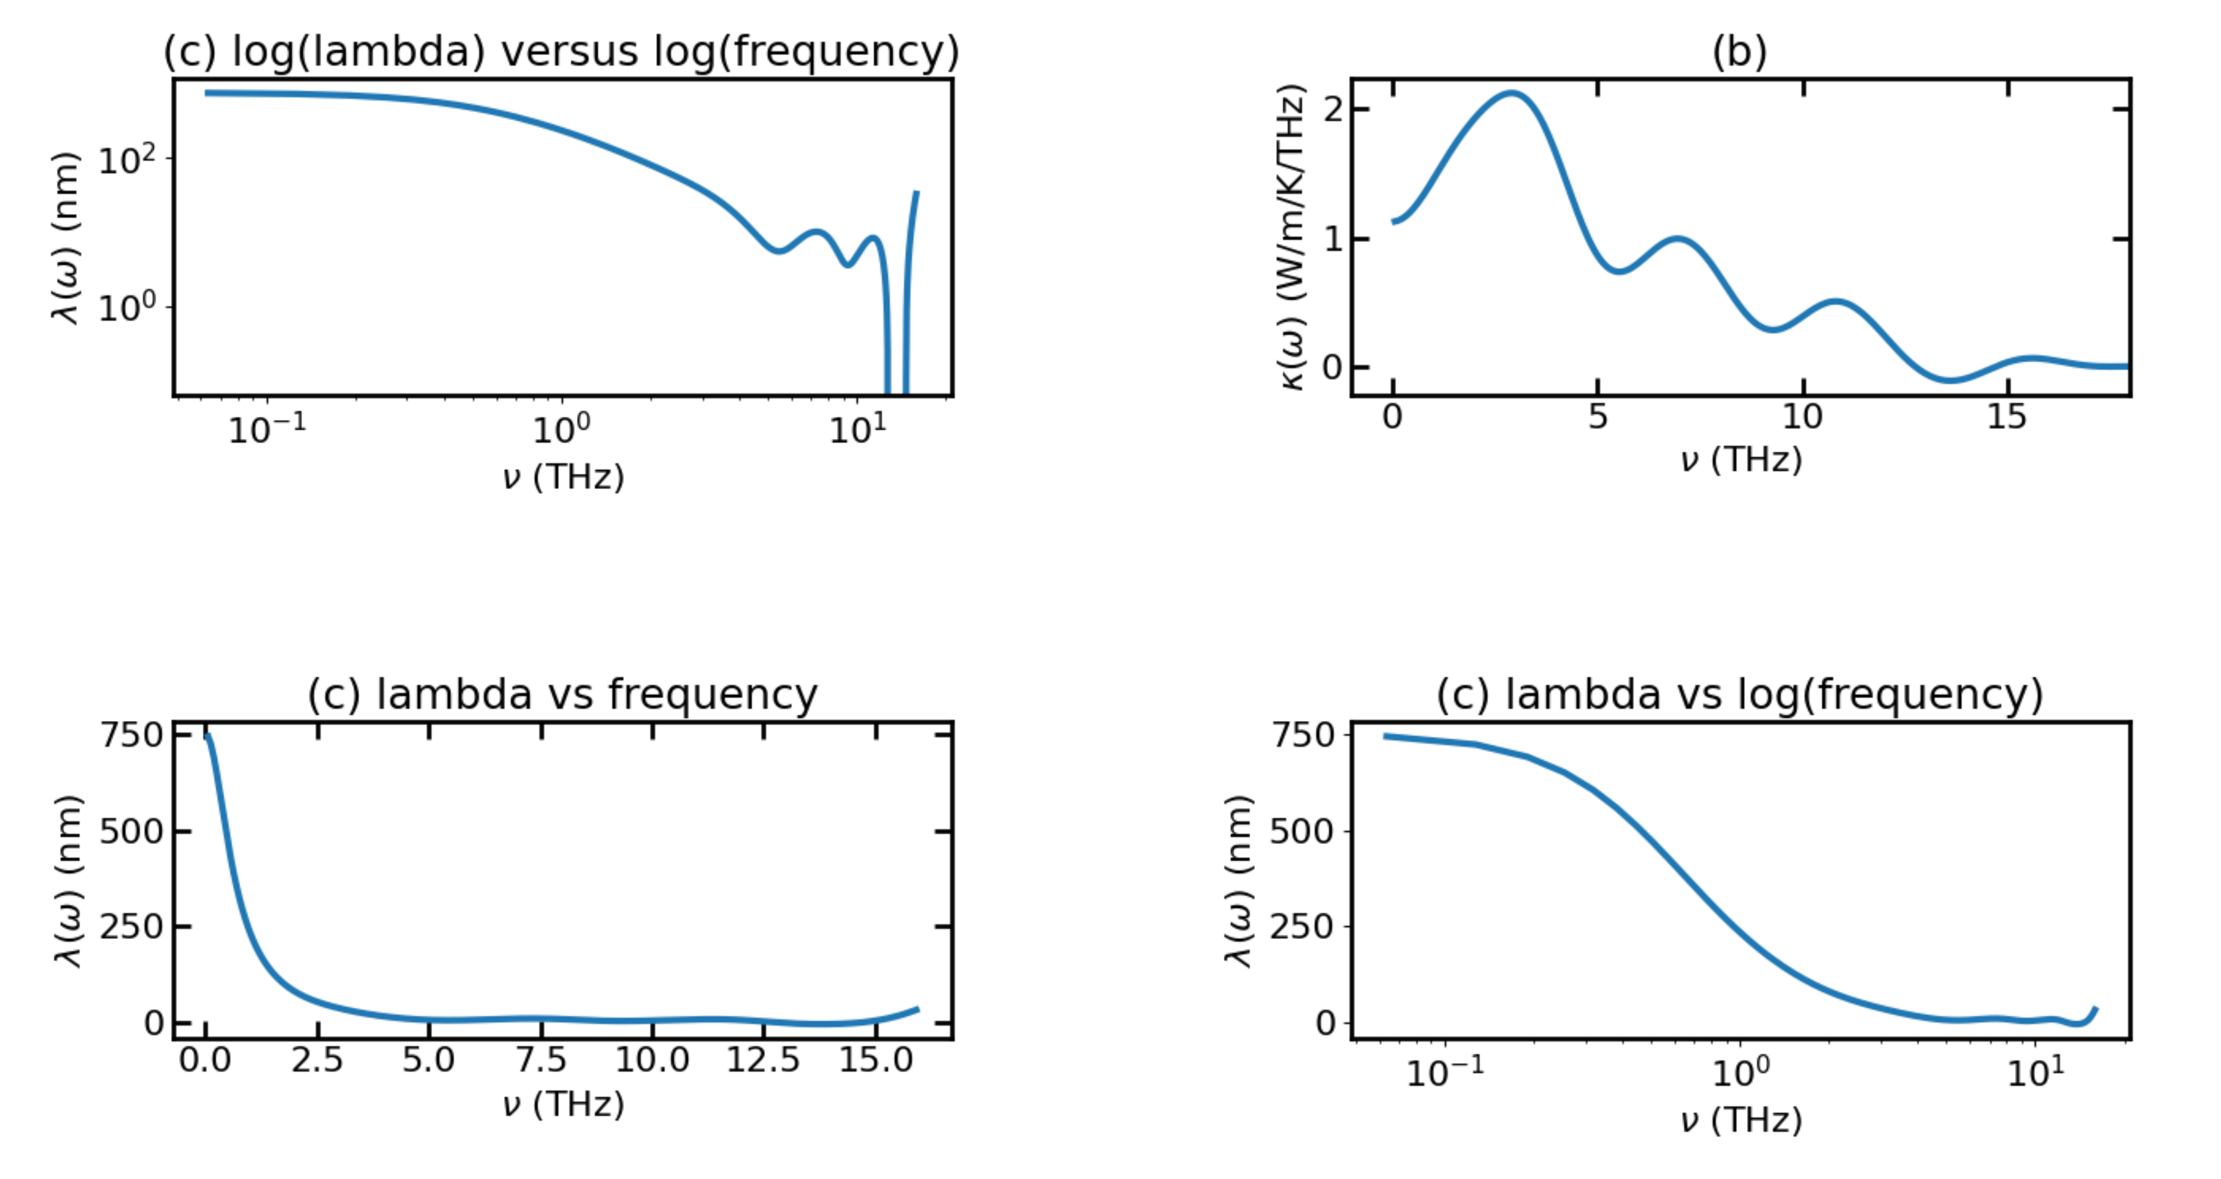
CoNiO - 300K – 0.0001

Slide 15
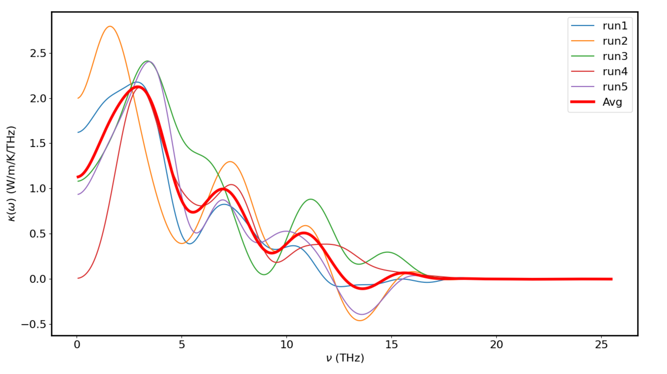
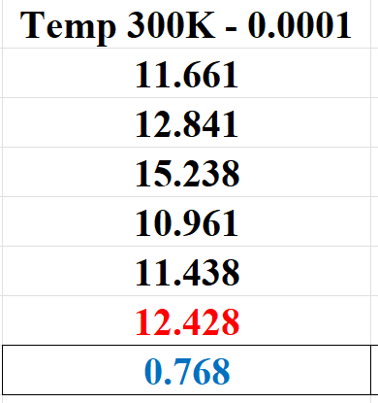
CoNiO - 300K – 0.0001

Slide 16
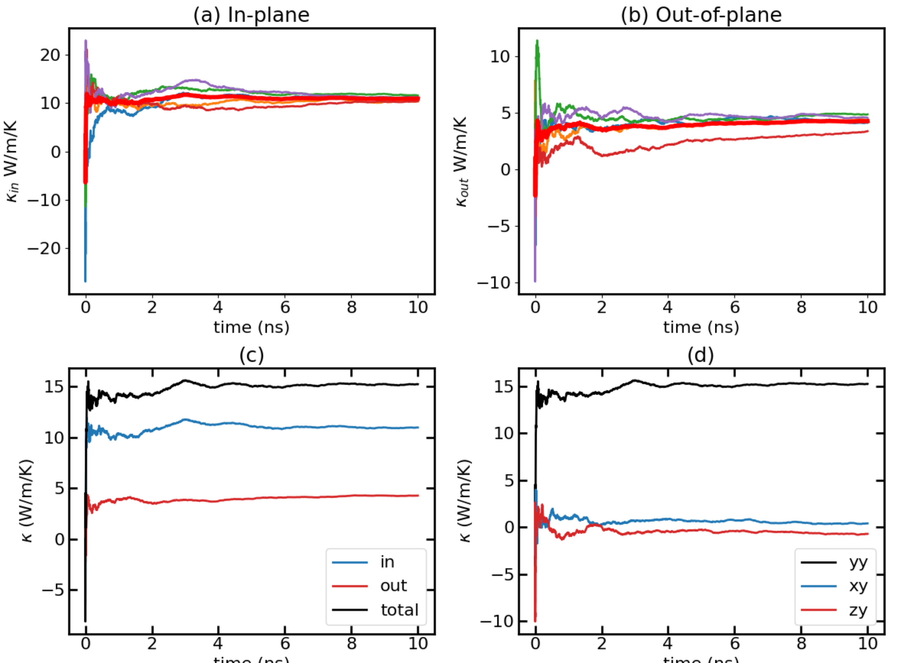
CoNiO - 300K – 0.0001 – 10M Runs

Slide 17
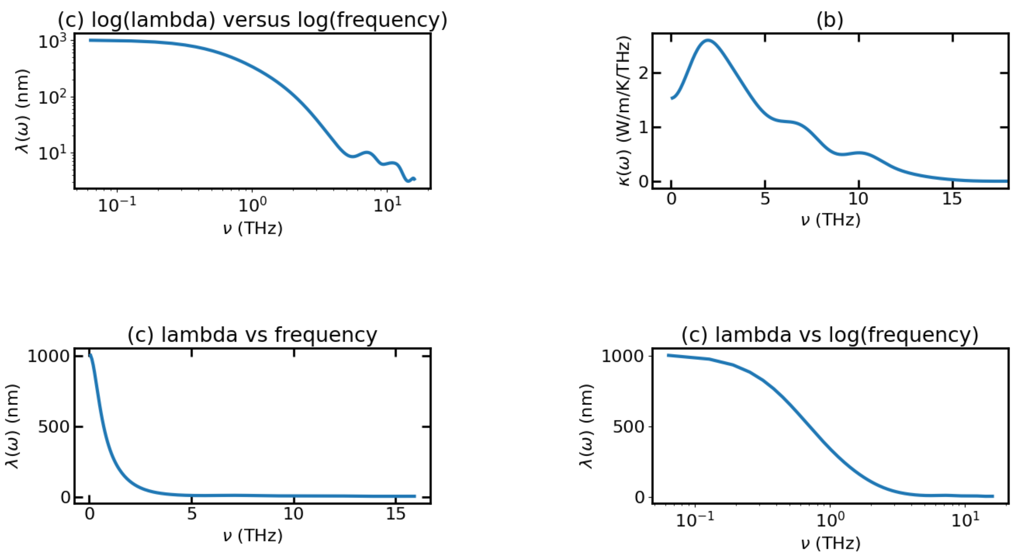
CoNiO - 300K – 0.0001 – 1M Runs

Slide 18
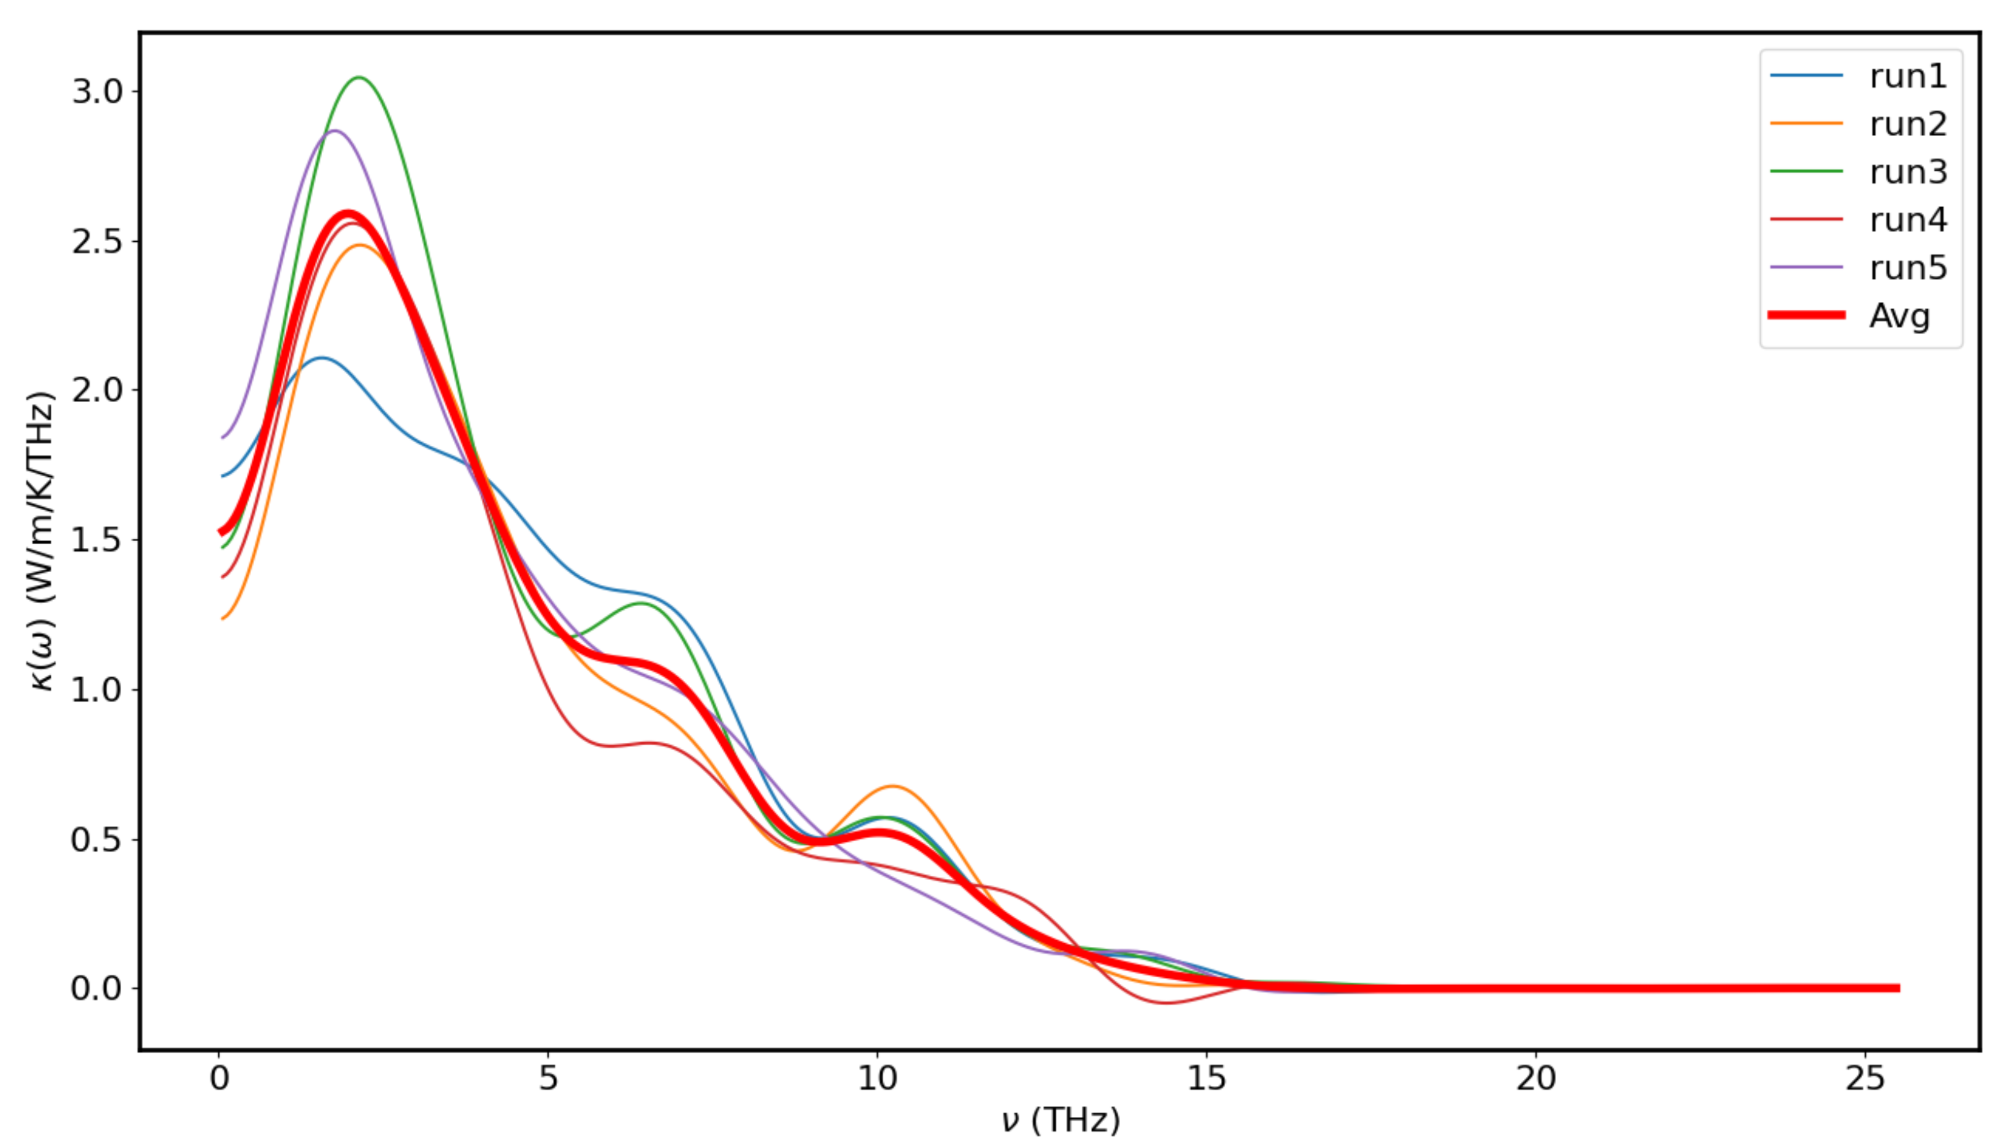
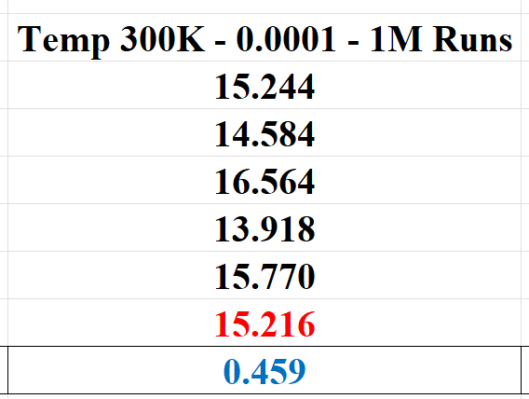
CoNiO - 300K – 0.0001 – 10M Runs

Slide 19
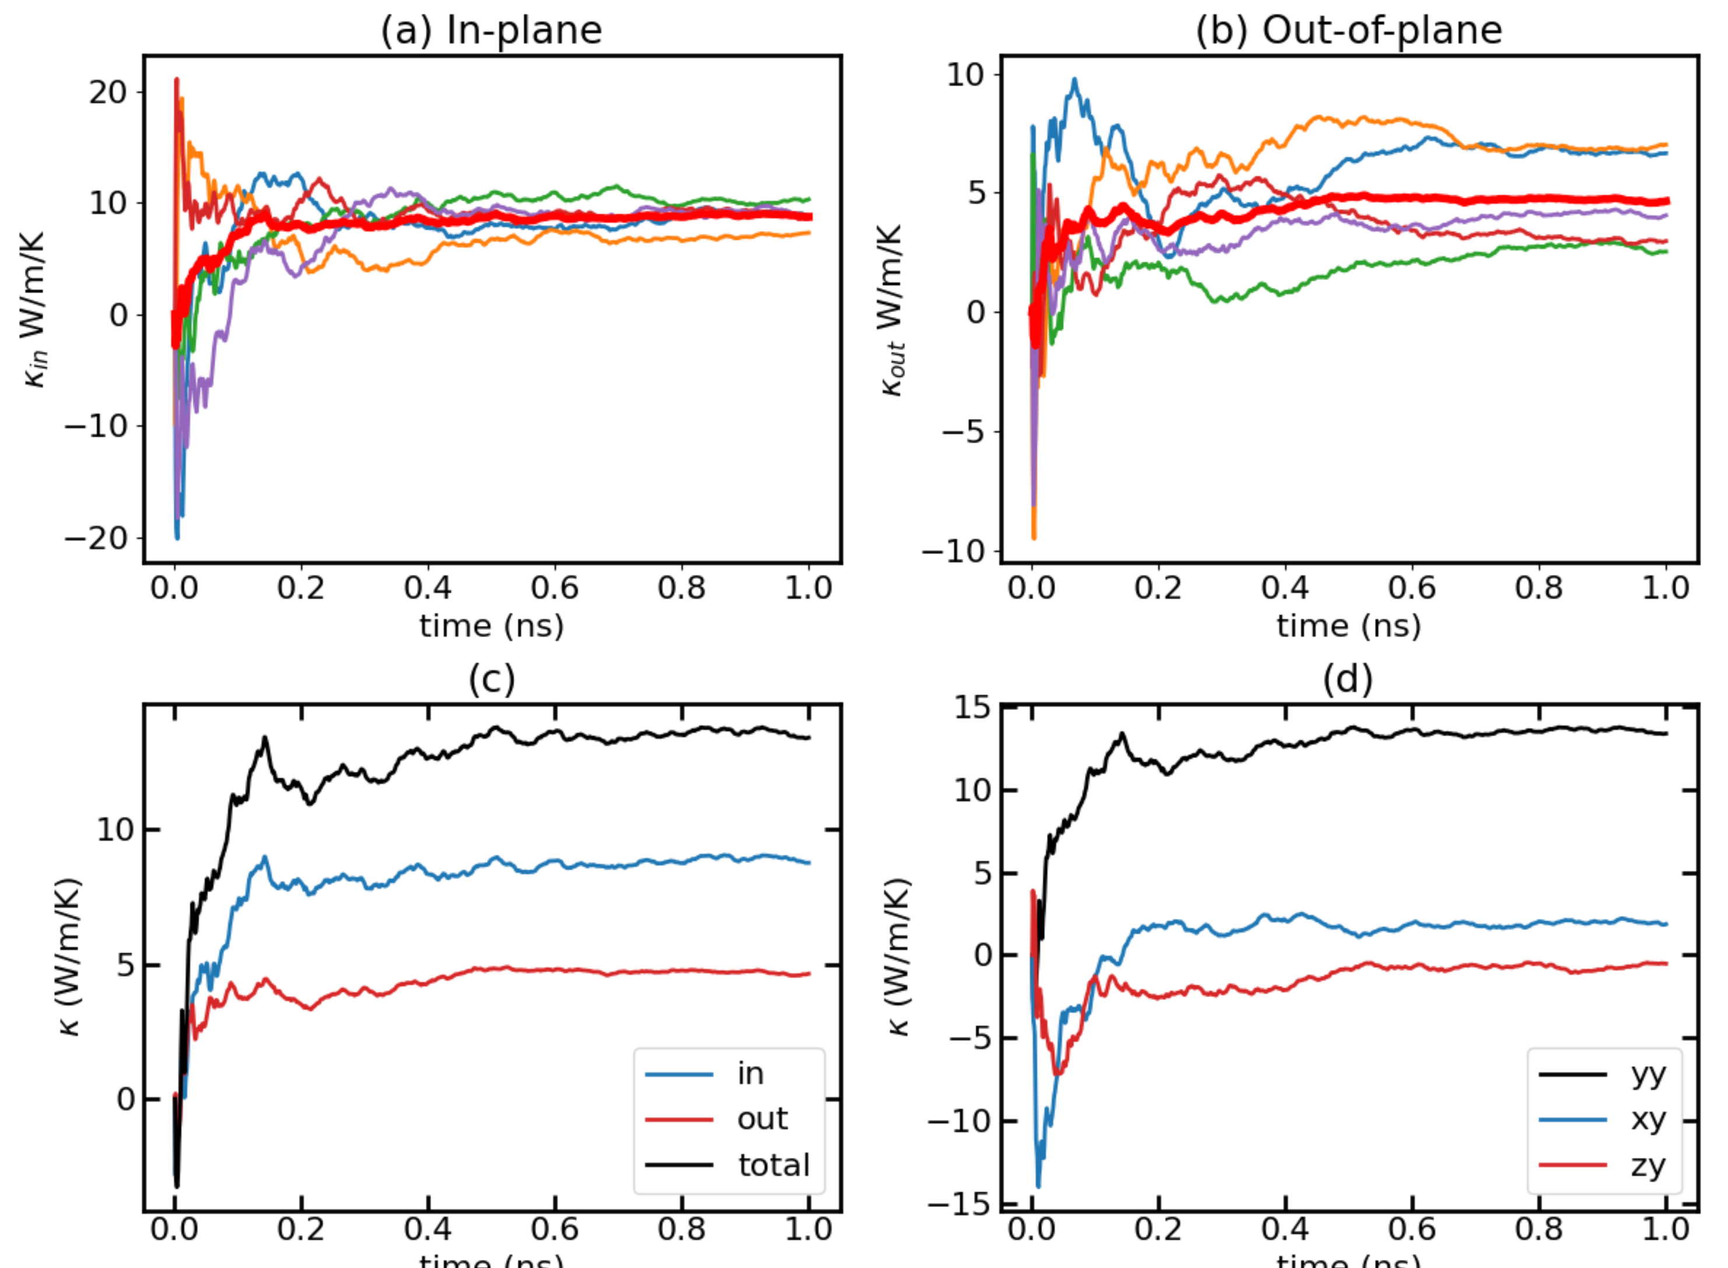
CoNiO - 300K – 0.00011

Slide 20
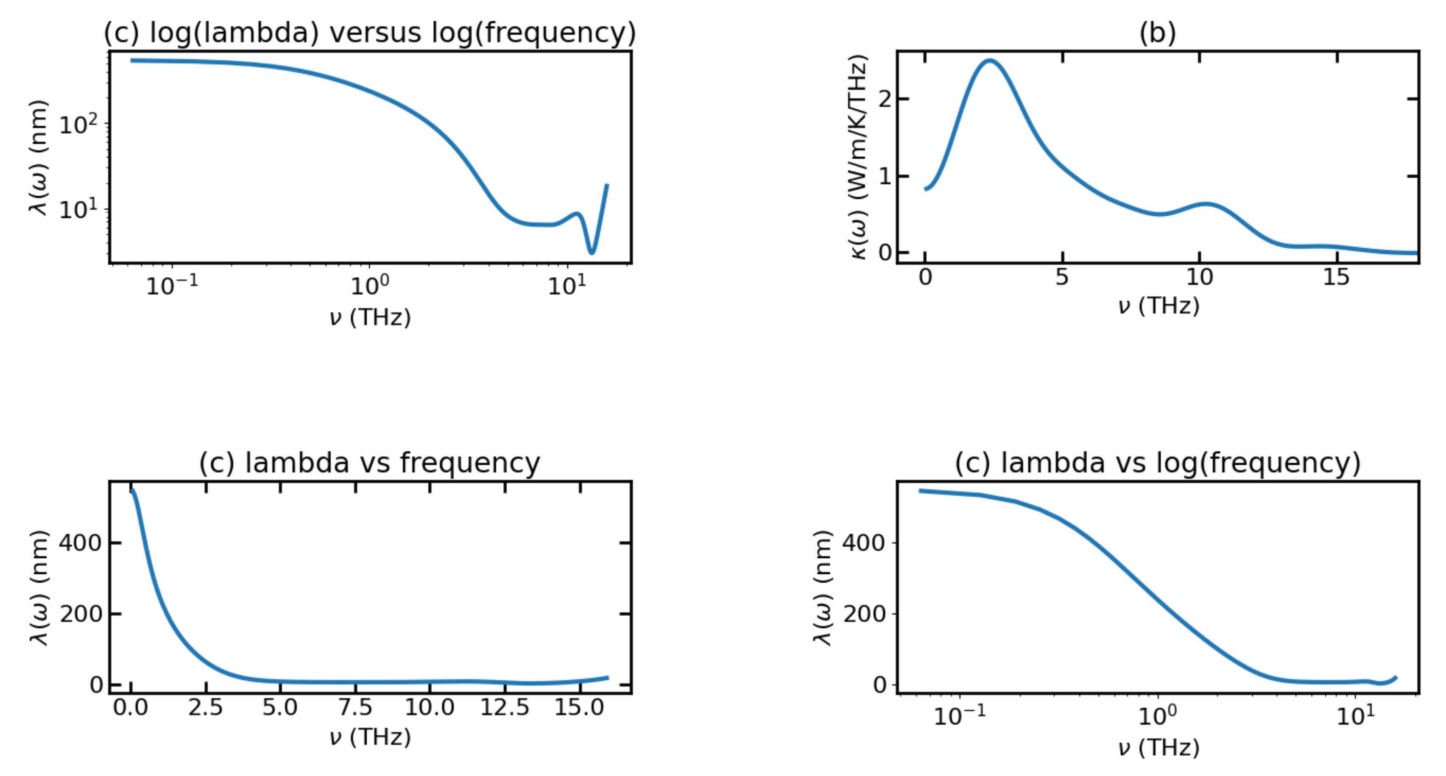
CoNiO - 300K – 0.00011

Slide 21
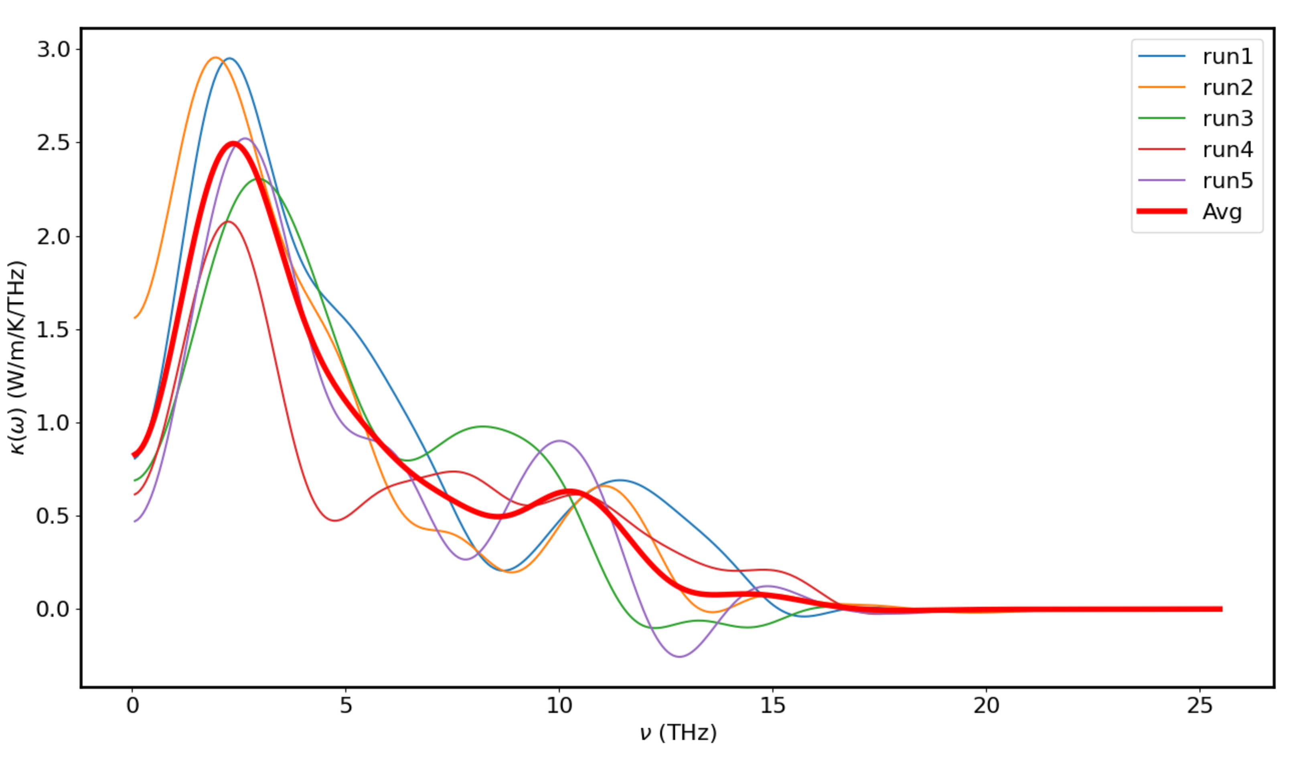
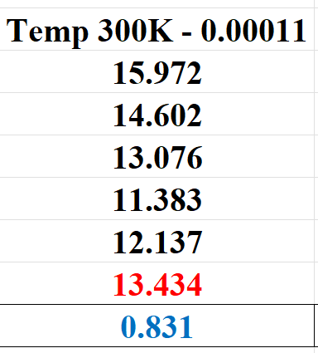
CoNiO - 300K – 0.00011

Slide 22
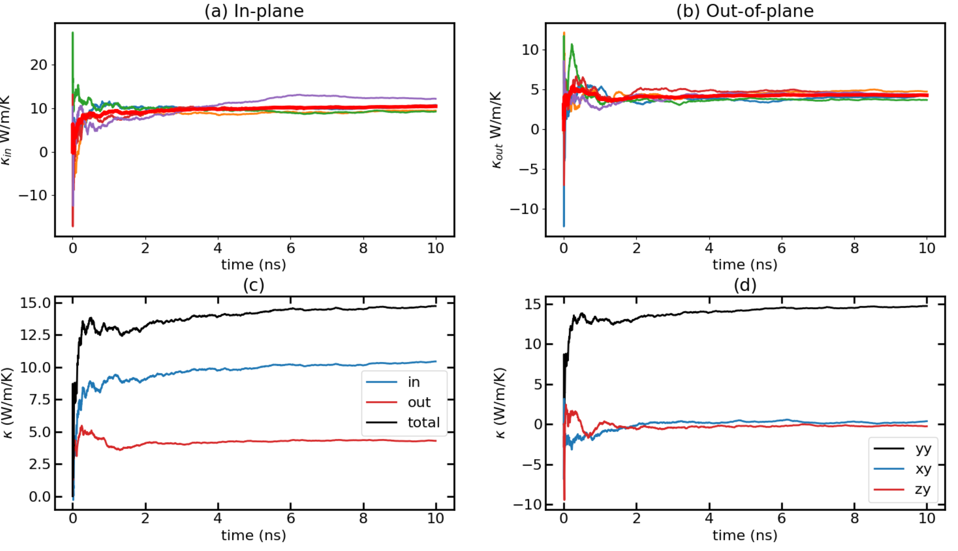
CoNiO - 300K – 0.00011 – 10M runs

Slide 23
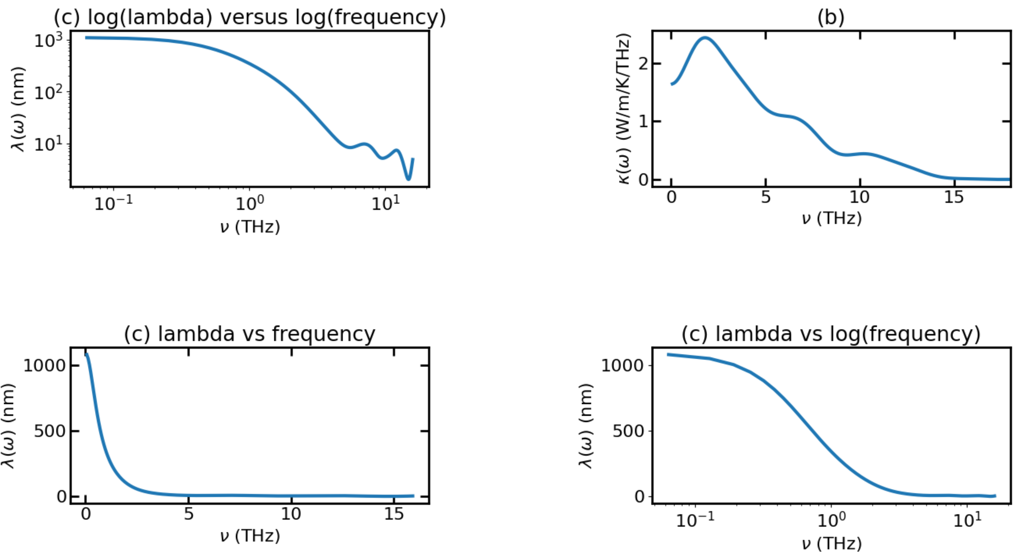
CoNiO - 300K – 0.00011 – 10M runs

Slide 24
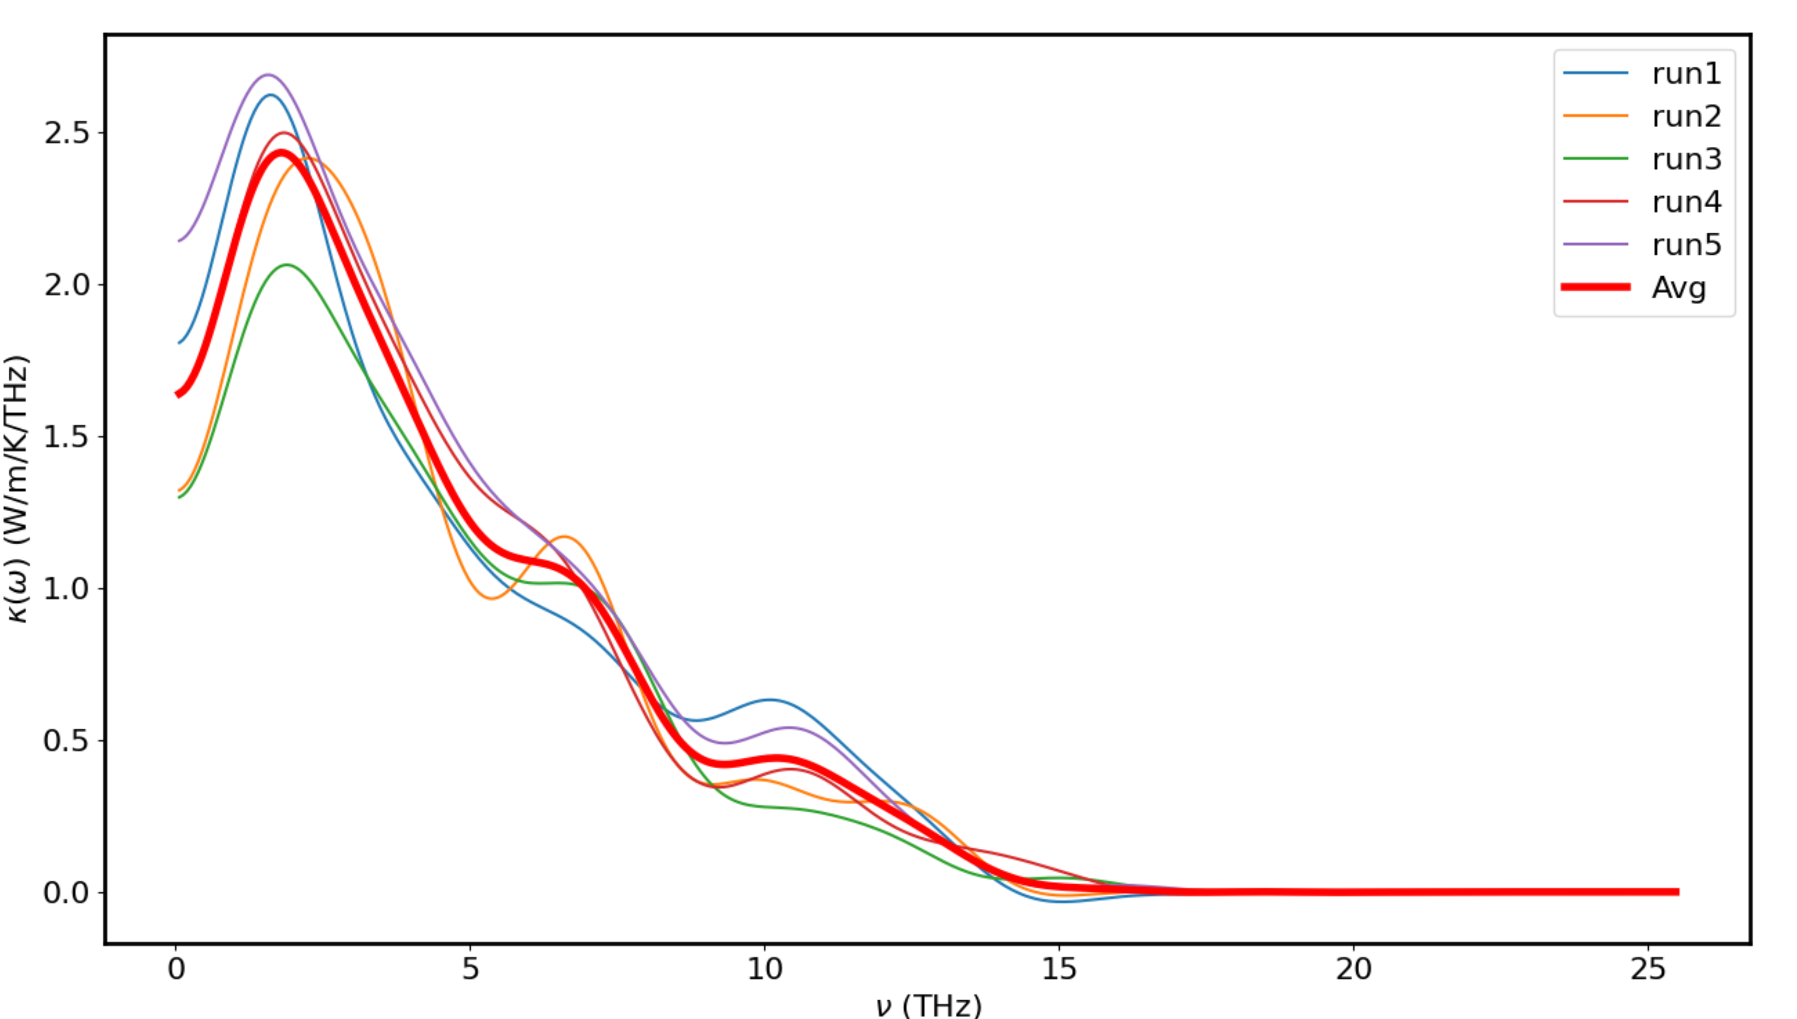
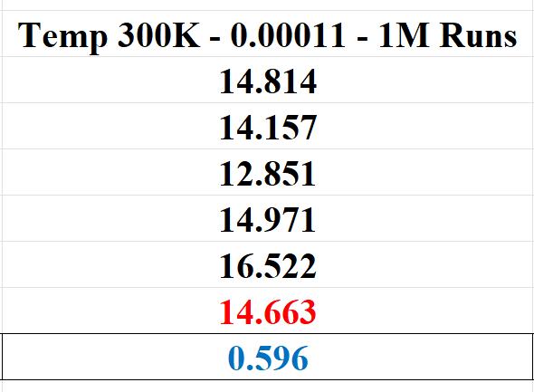
CoNiO - 300K – 0.00011 – 10M runs

Slide 25
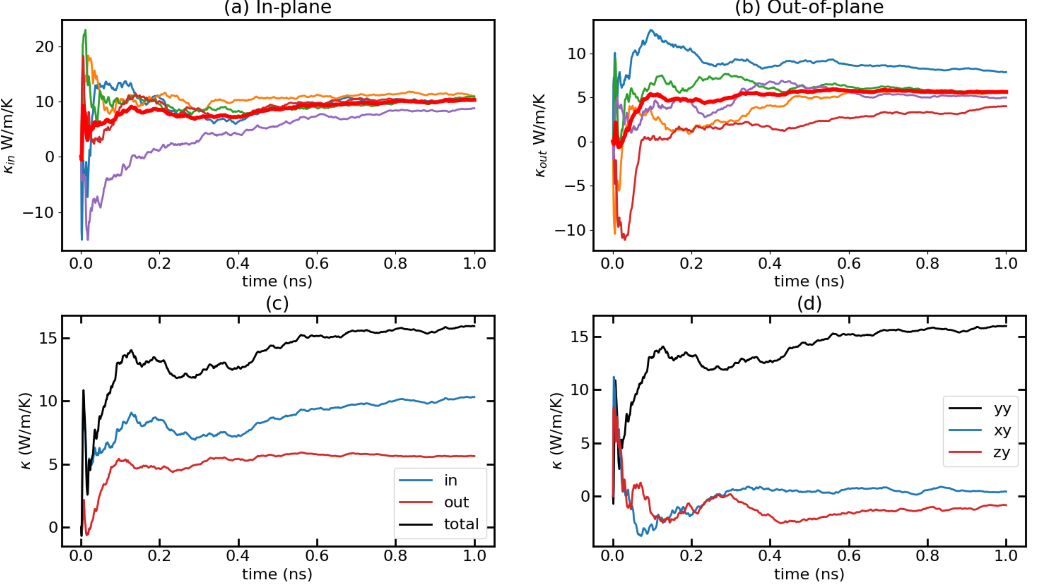
CoNiO - 300K – 0.00012

Slide 26
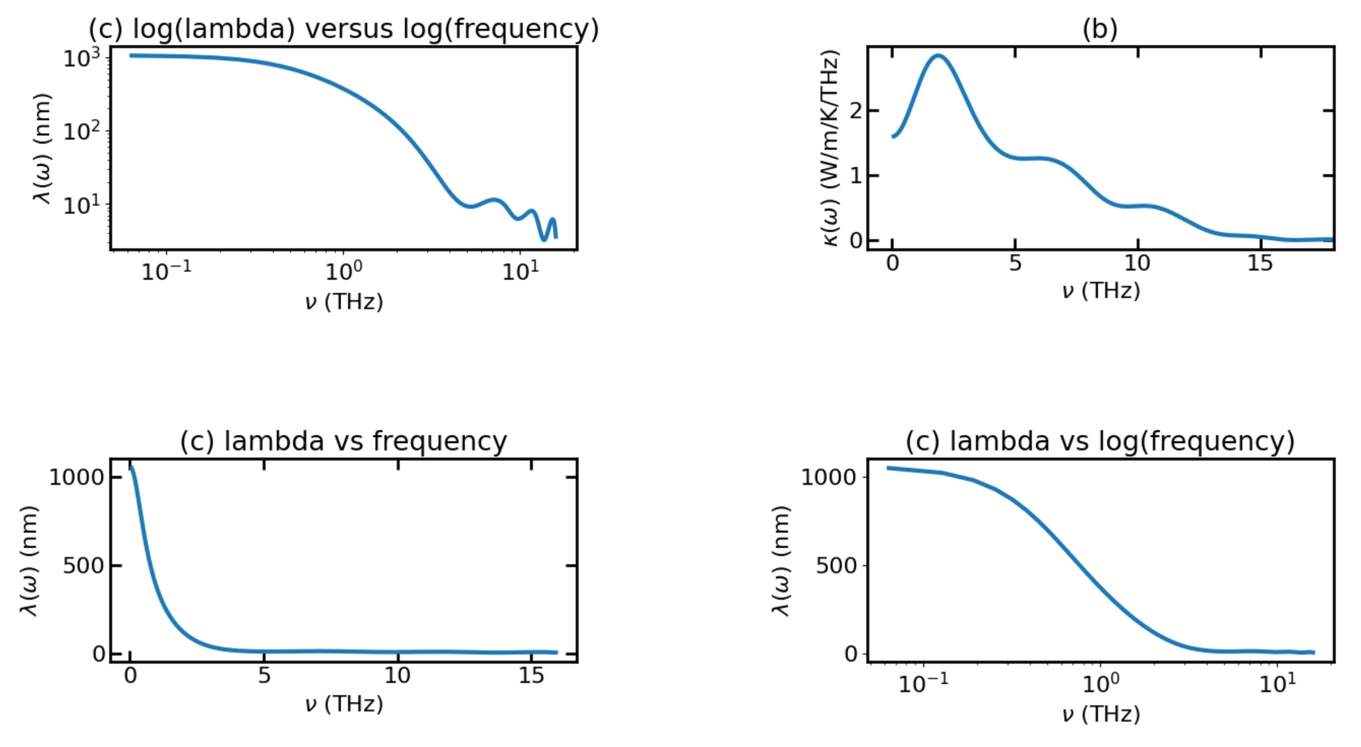
CoNiO - 300K – 0.00012

Slide 27
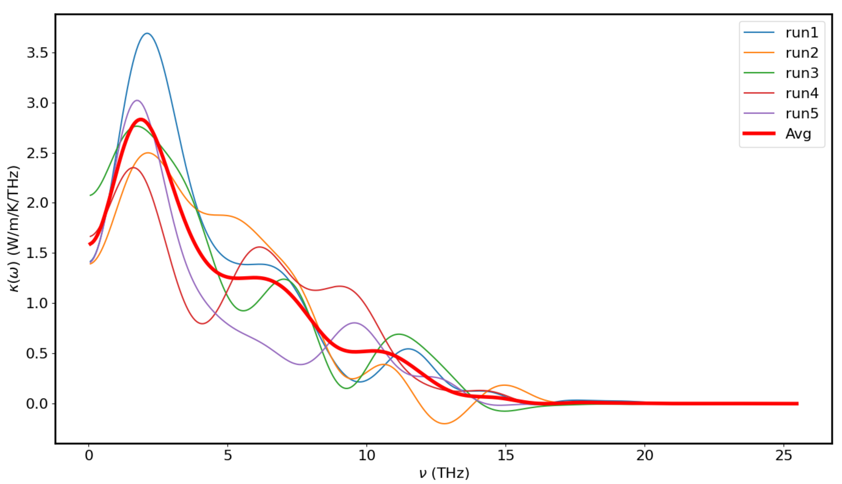
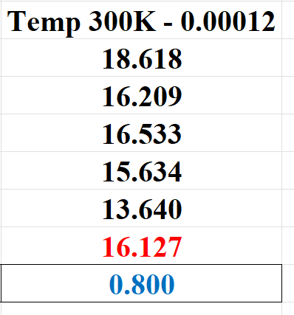
CoNiO - 300K – 0.00012

Slide 28
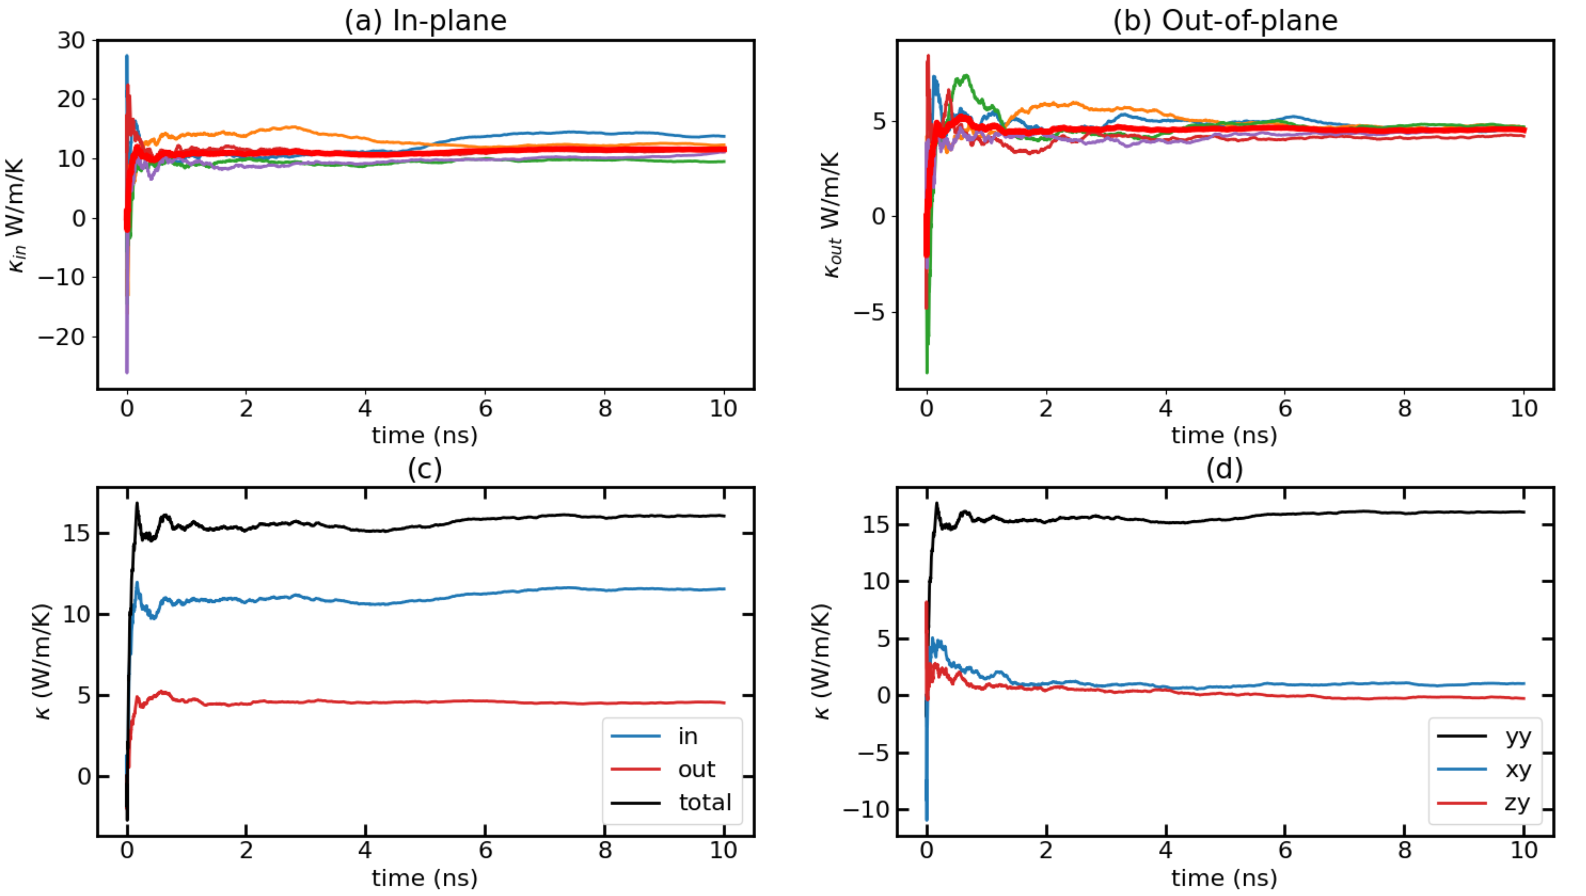
CoNiO - 300K – 0.00012 – 10M runs

Slide 29
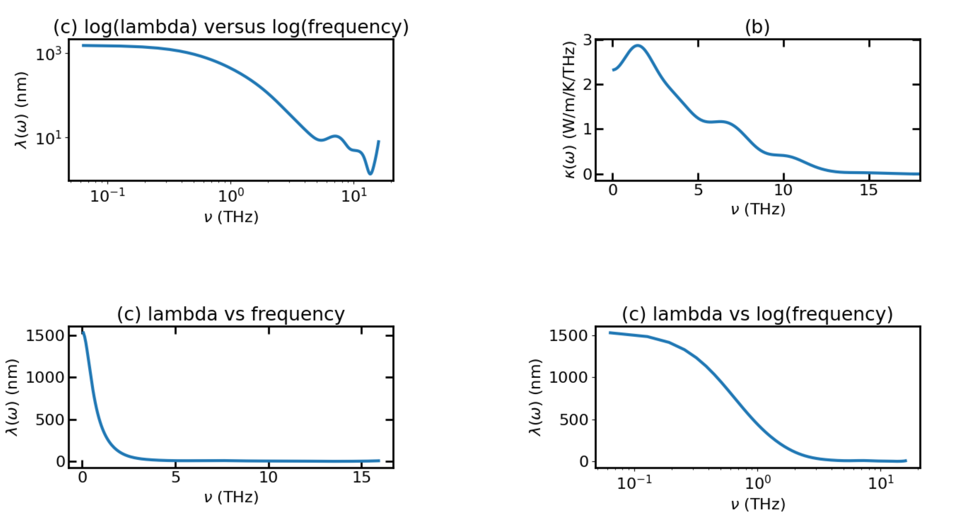
CoNiO - 300K – 0.00012 – 10M runs

Slide 30
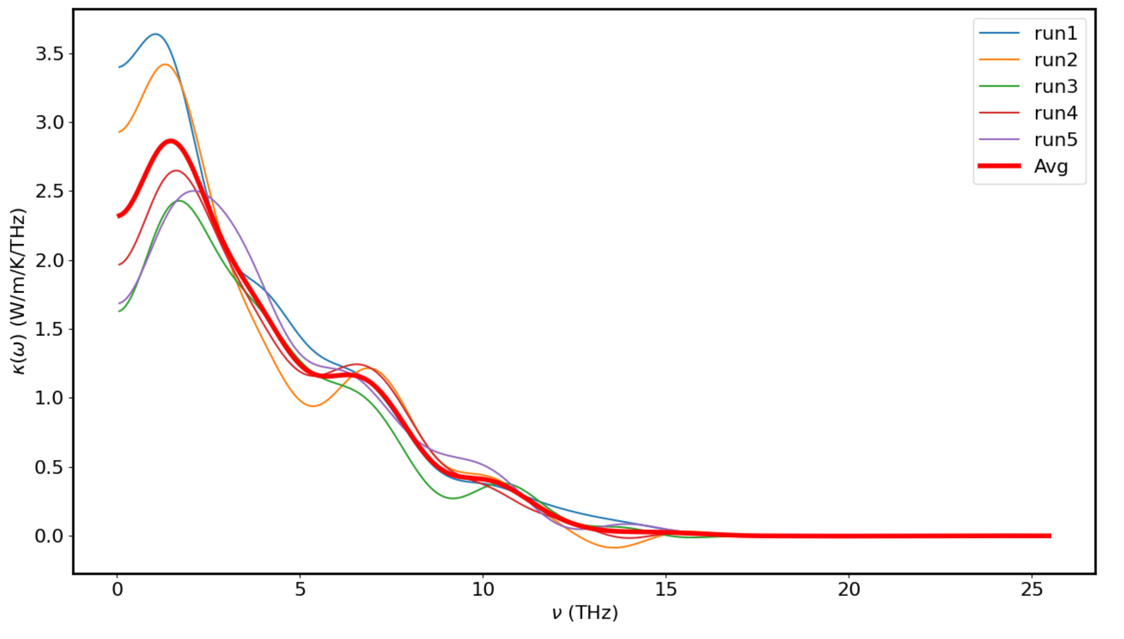
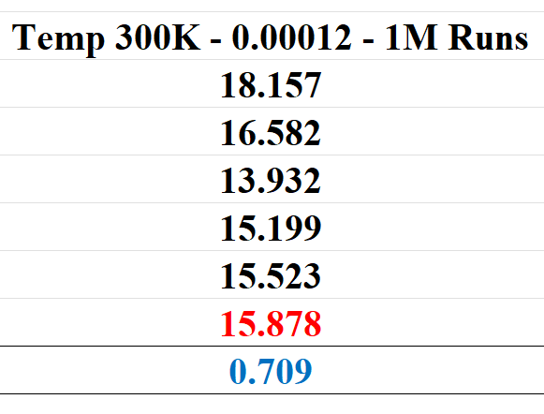
CoNiO - 300K – 0.00012 – 10M runs

Slide 31
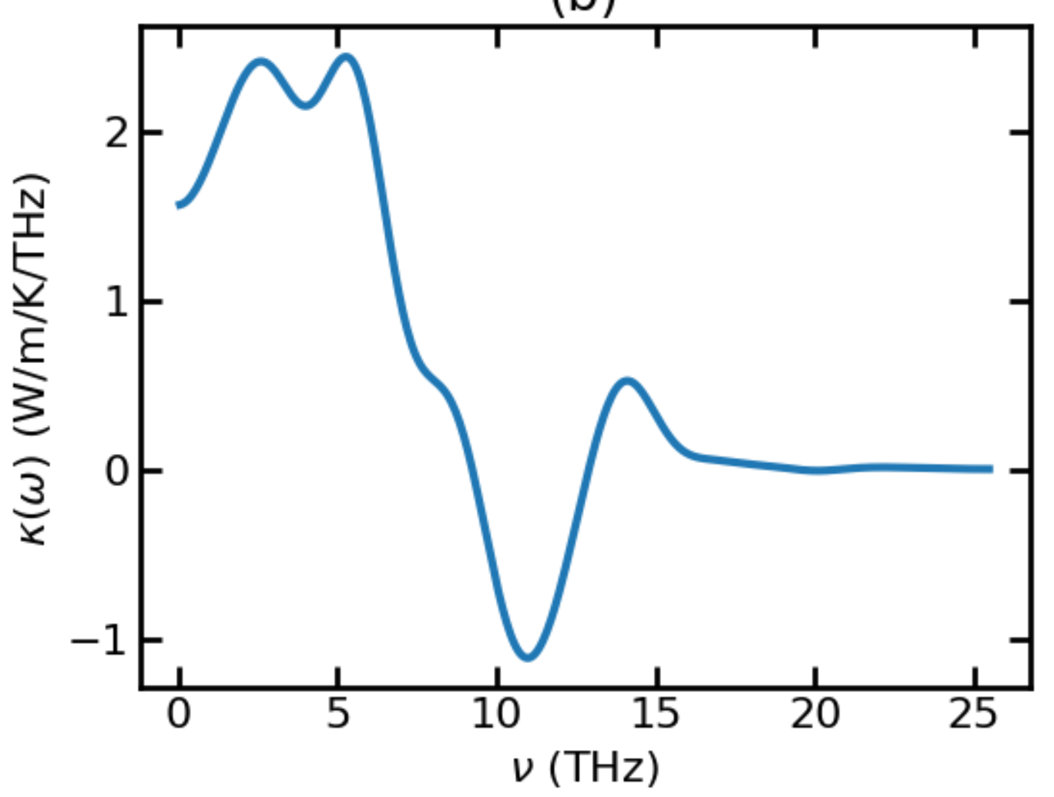
CoNiO - 300K – 0.00001 and 0.0005

Slide 32
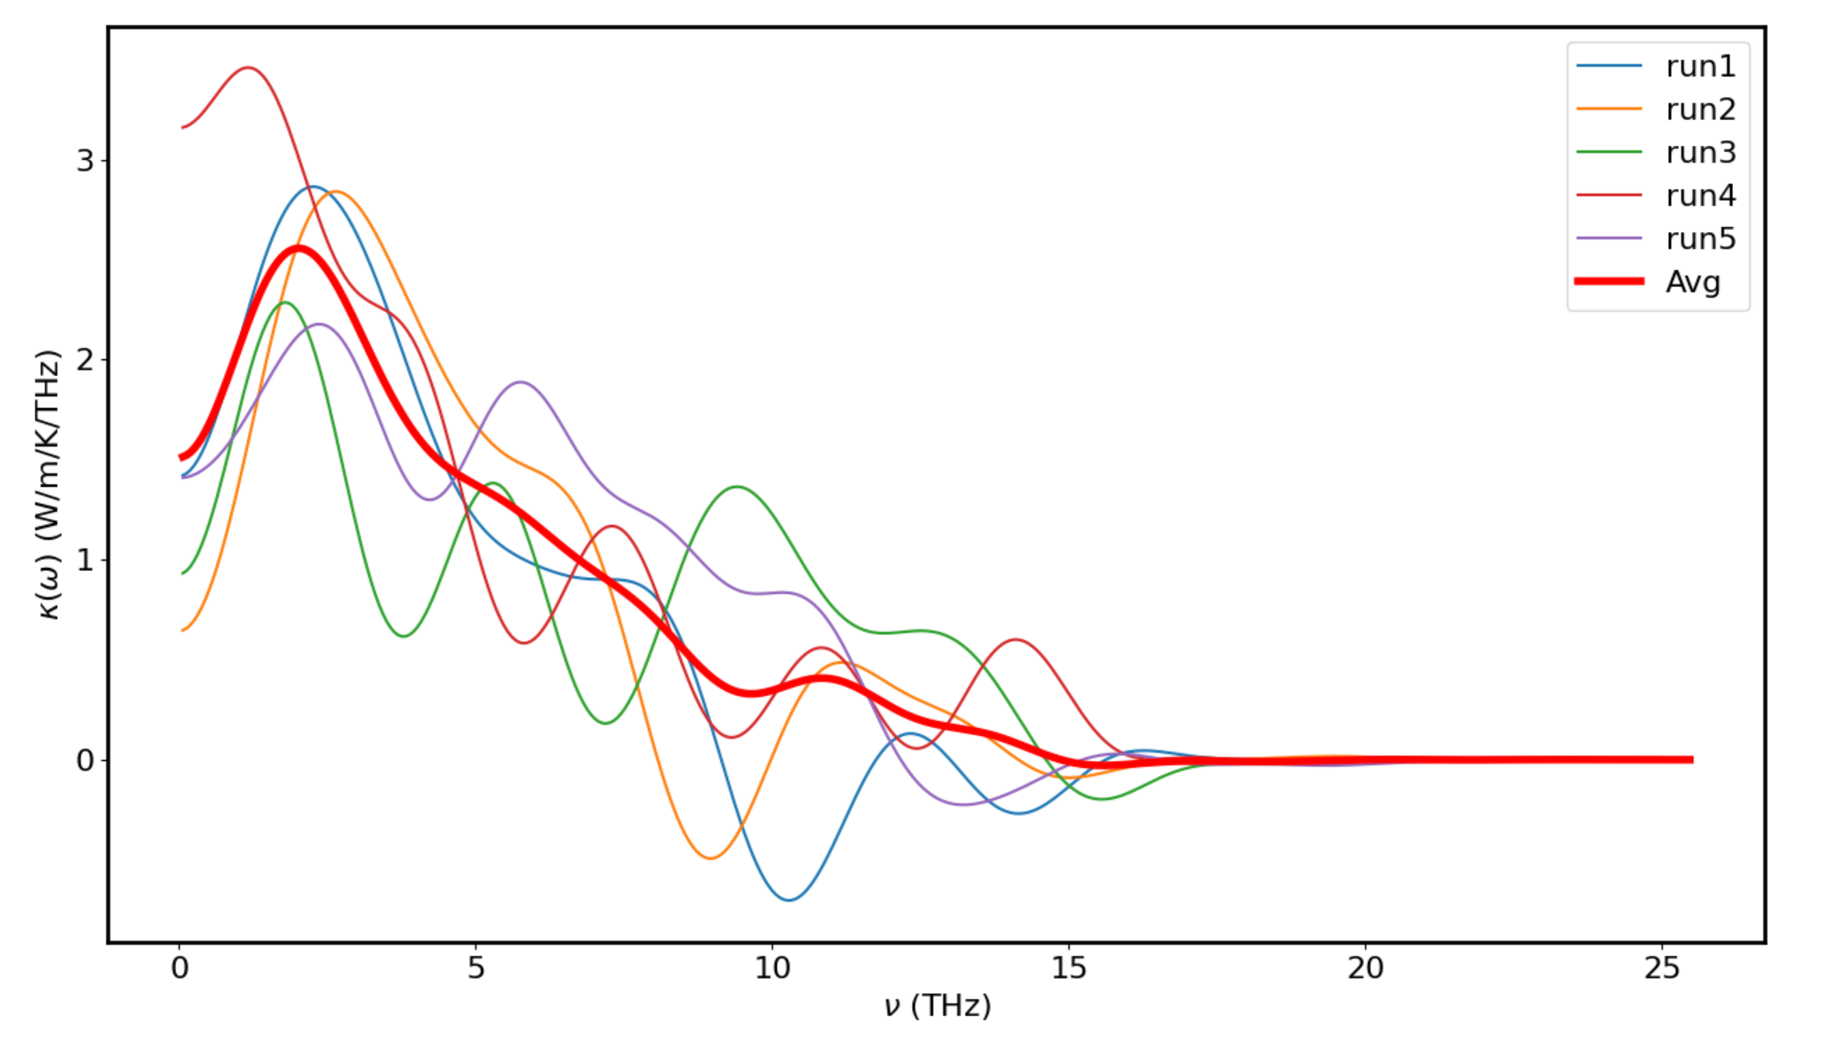
CoNiO - 300K – 0.00009

Slide 33
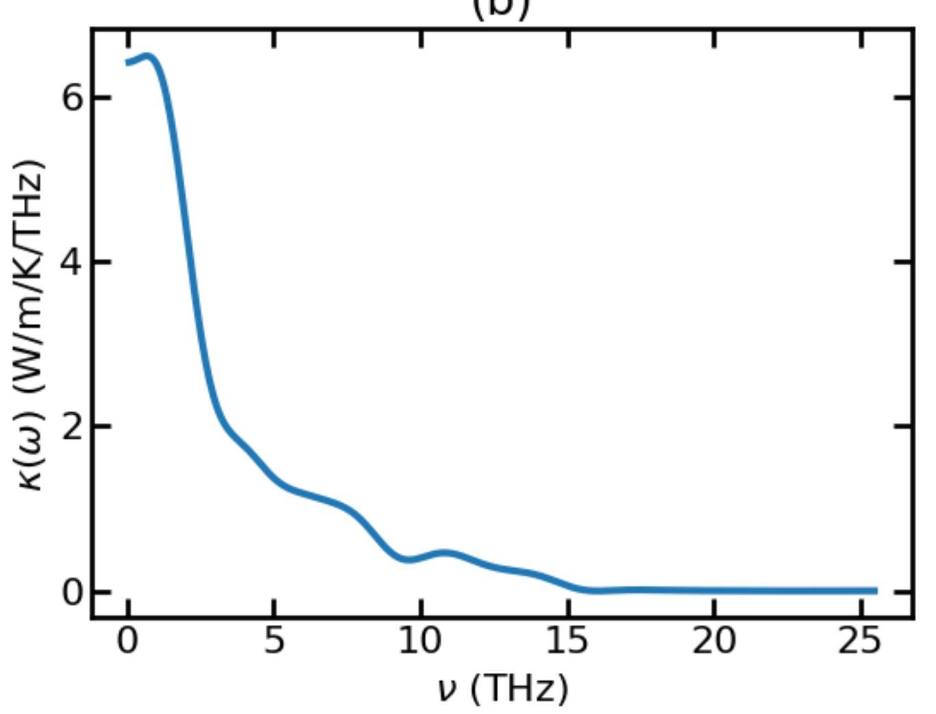
CoNiO - 300K – 0.00013 and 0.00014
Weird behavior and inconsistency

Slide 34
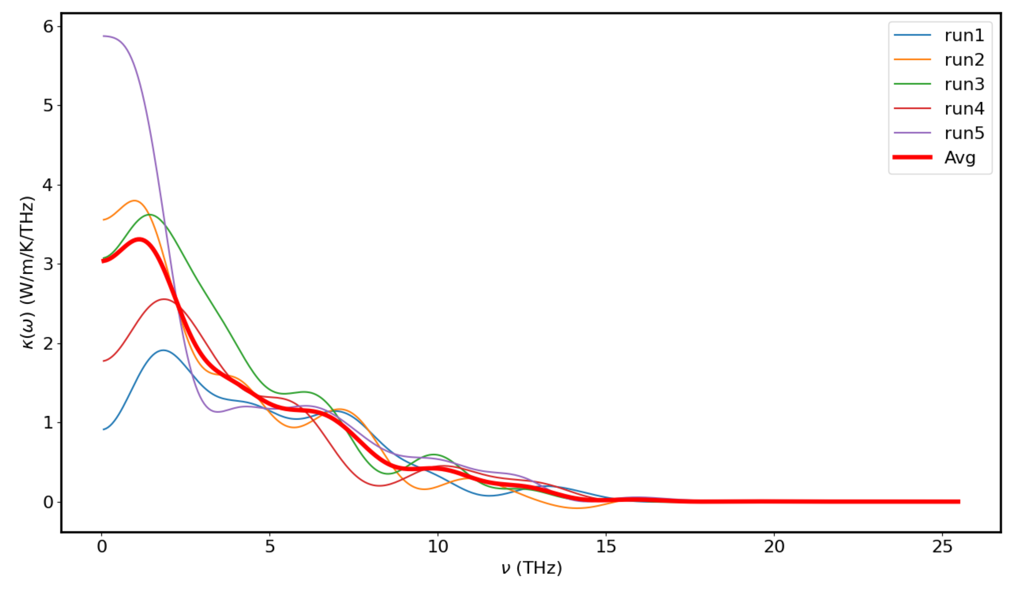
CoNiO - 300K – 0.00018

Slide 35
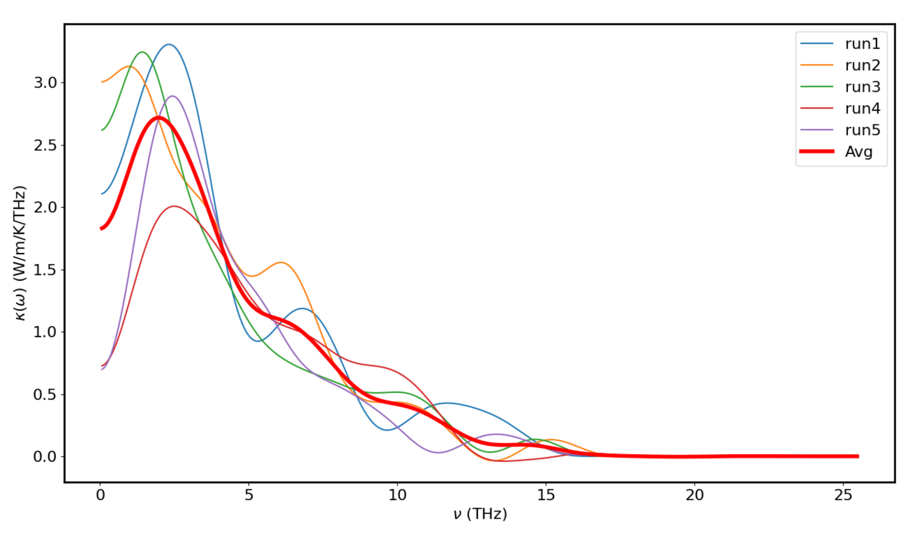
CoNiO - 300K – 0.0002

Slide 36
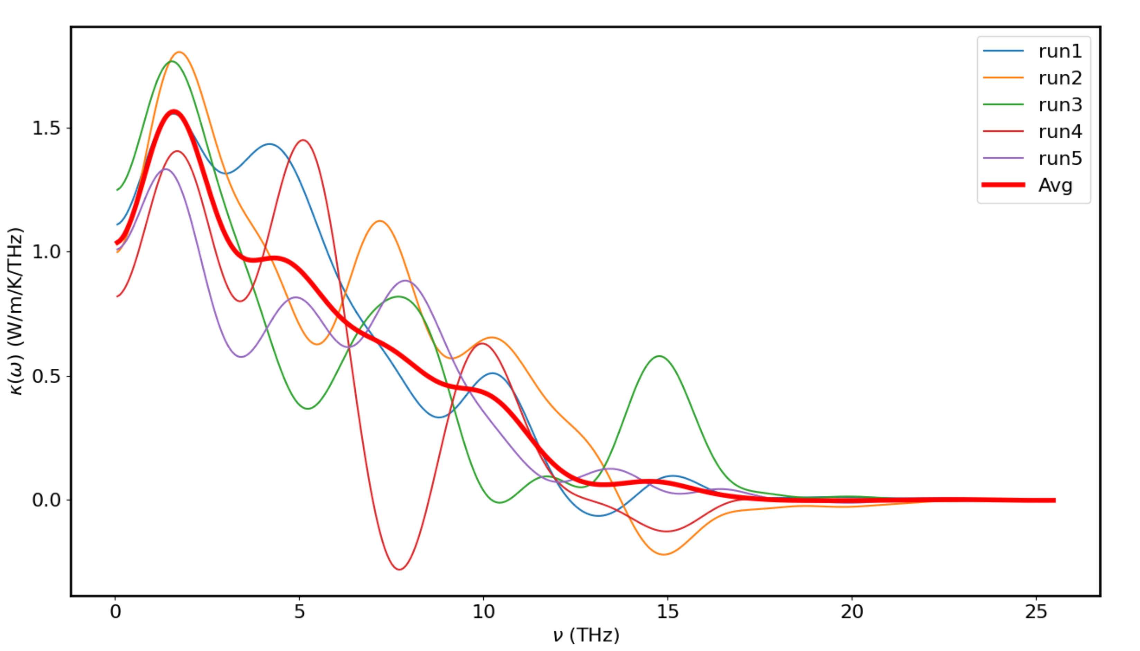
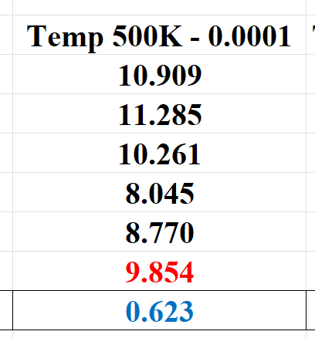
CoNiO - 500K – 0.0001

Slide 37
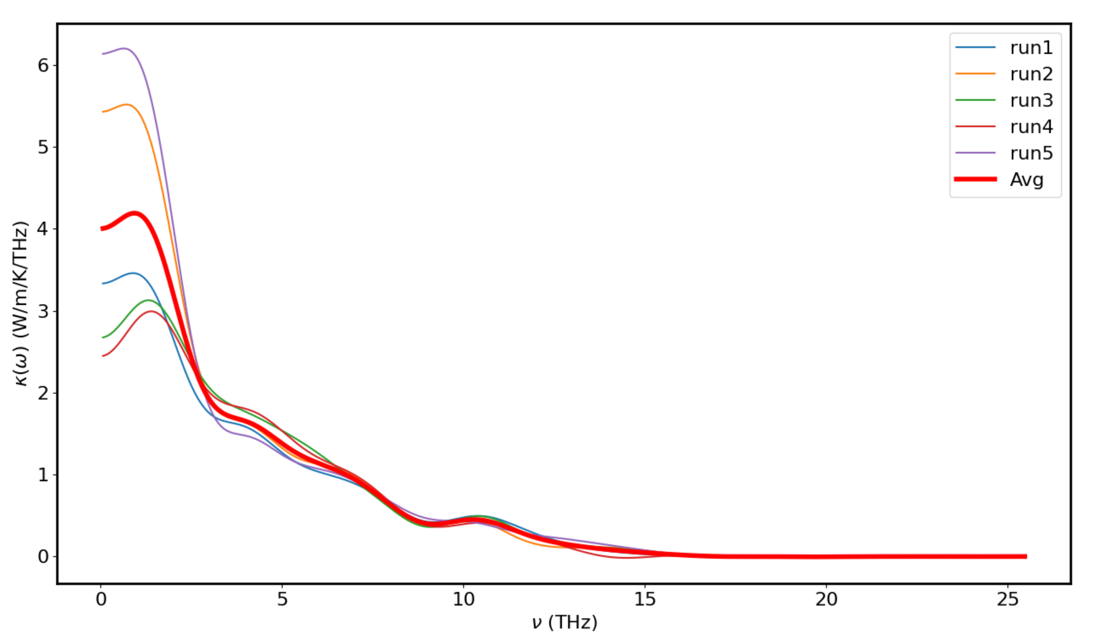
CoNiO - 500K – 0.00015 – 10M

Slide 38
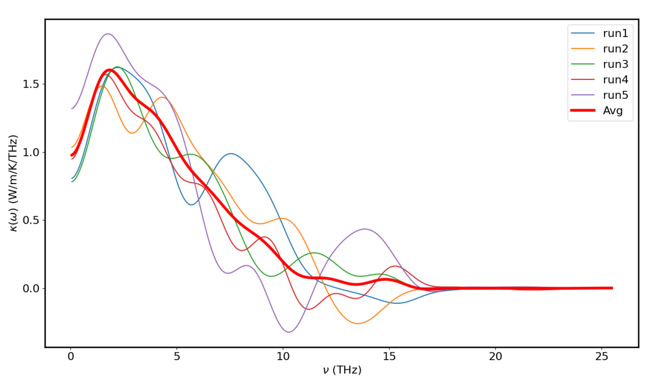
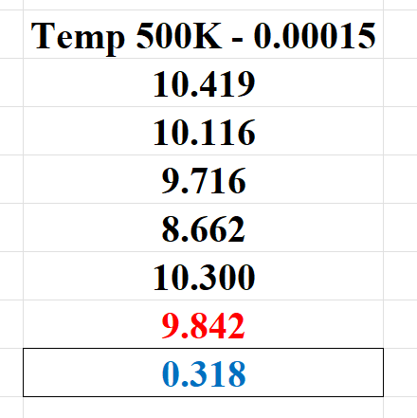
CoNiO - 500K – 0.00015

Slide 39
CoNiO - 500K – 0.00015 – 10M

Slide 40
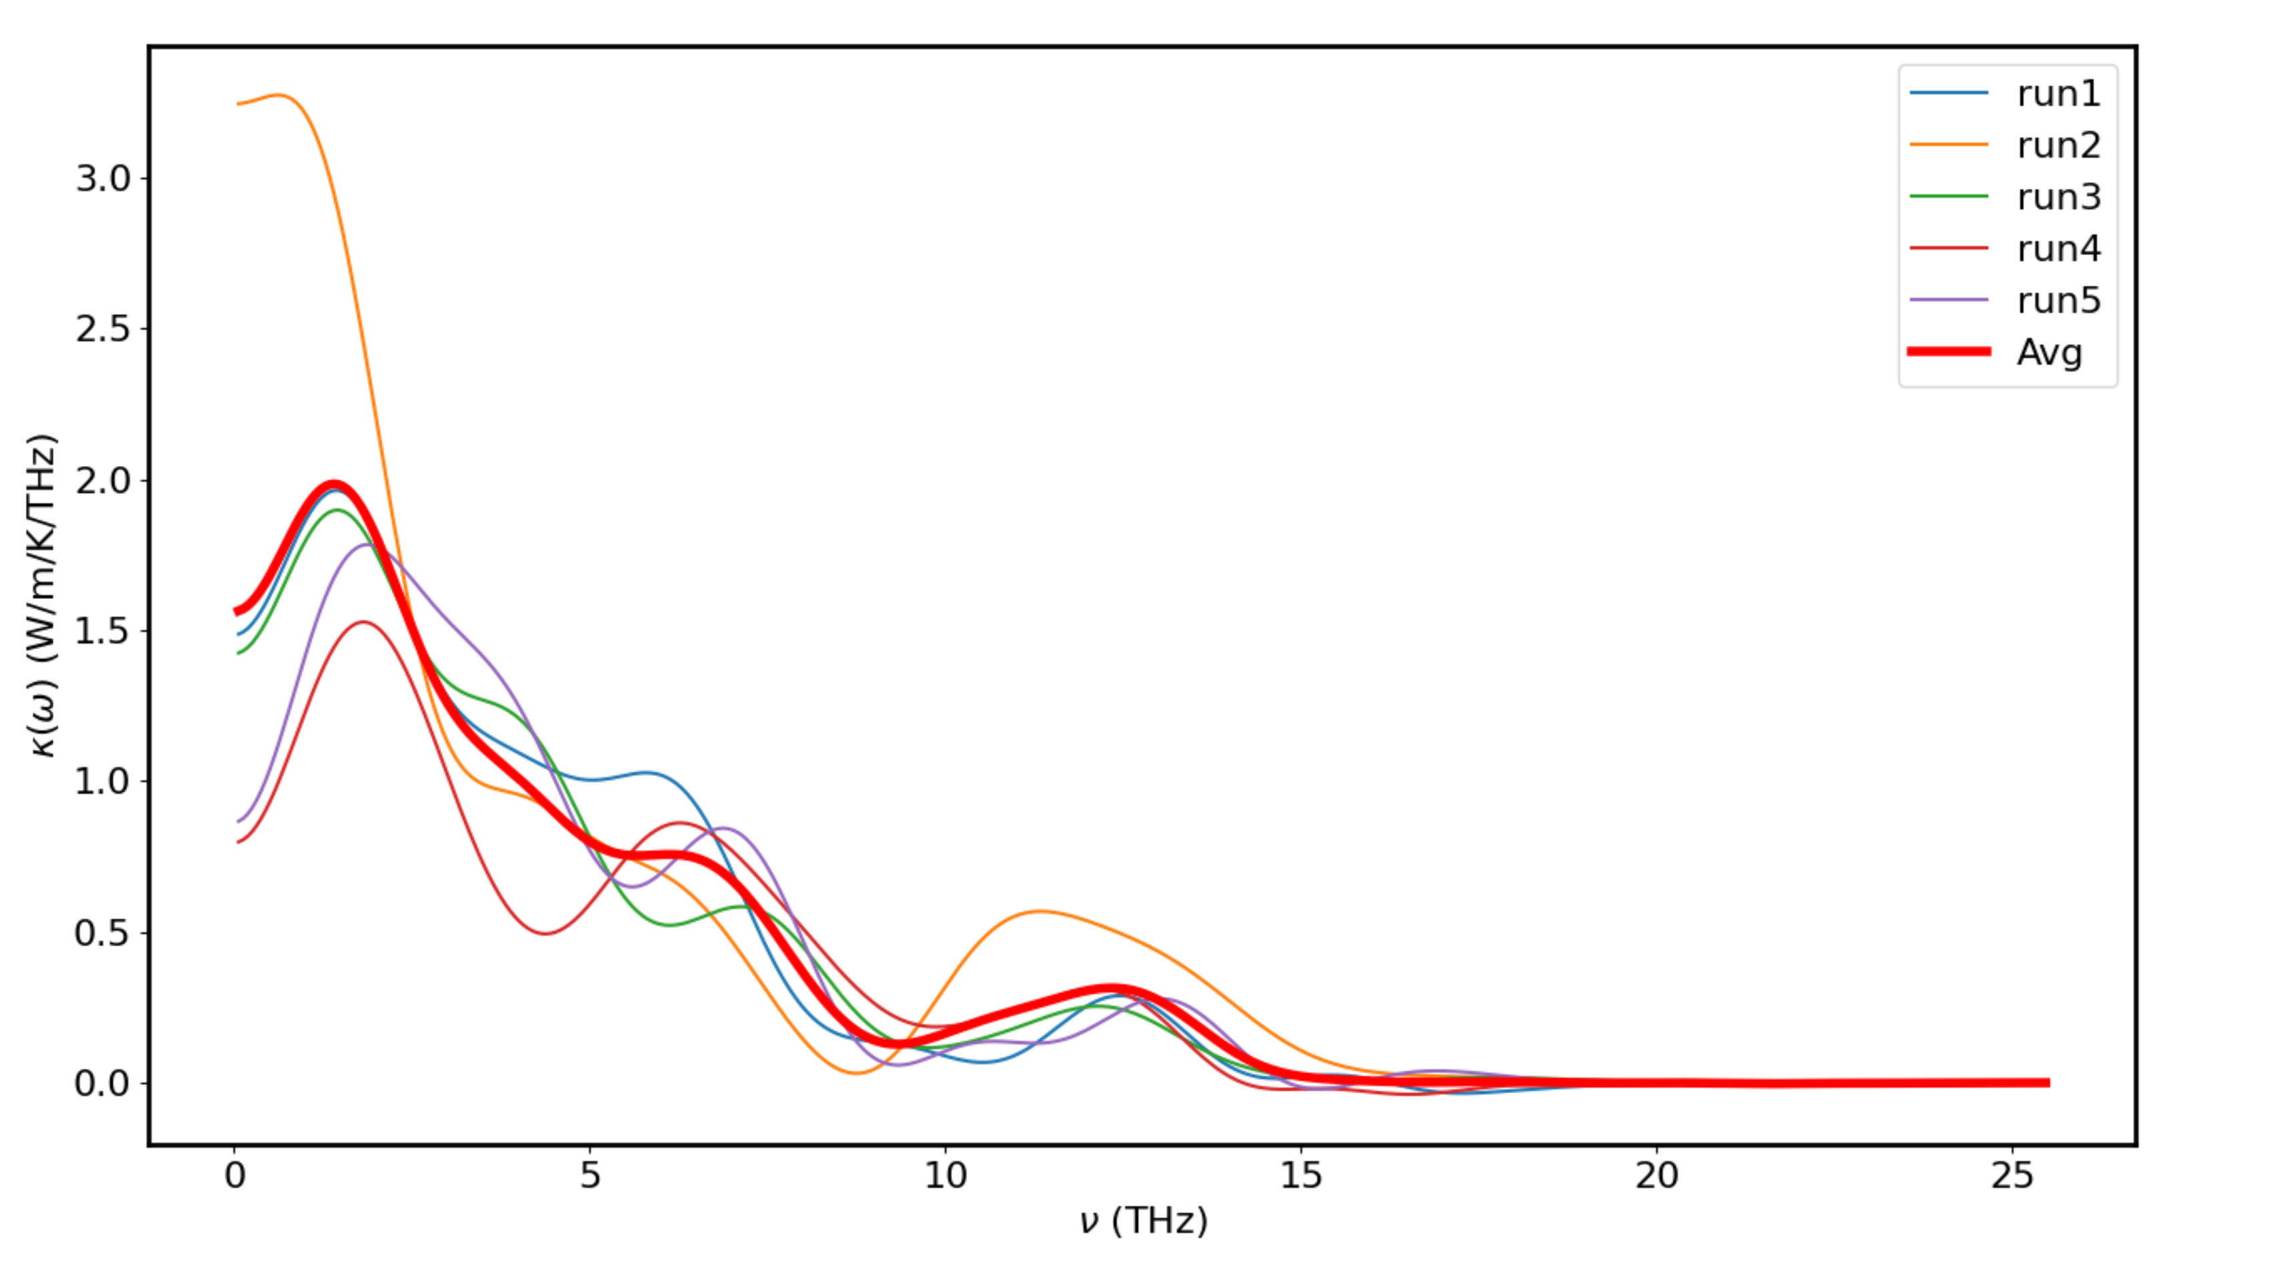
CoNiO - 500K – 0.00018 – chạy lại Run2

Slide 41
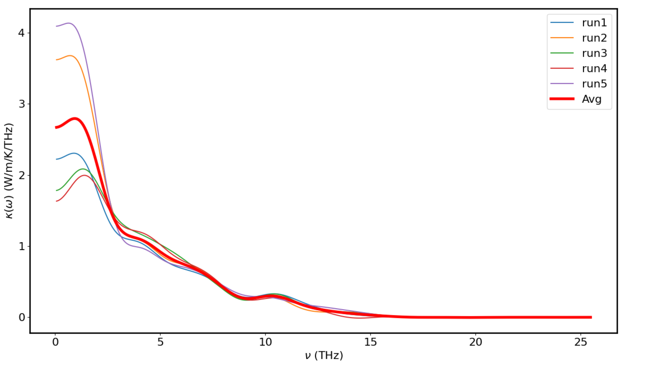
CoNiO - 500K – 0.00018 – 10M

Slide 42
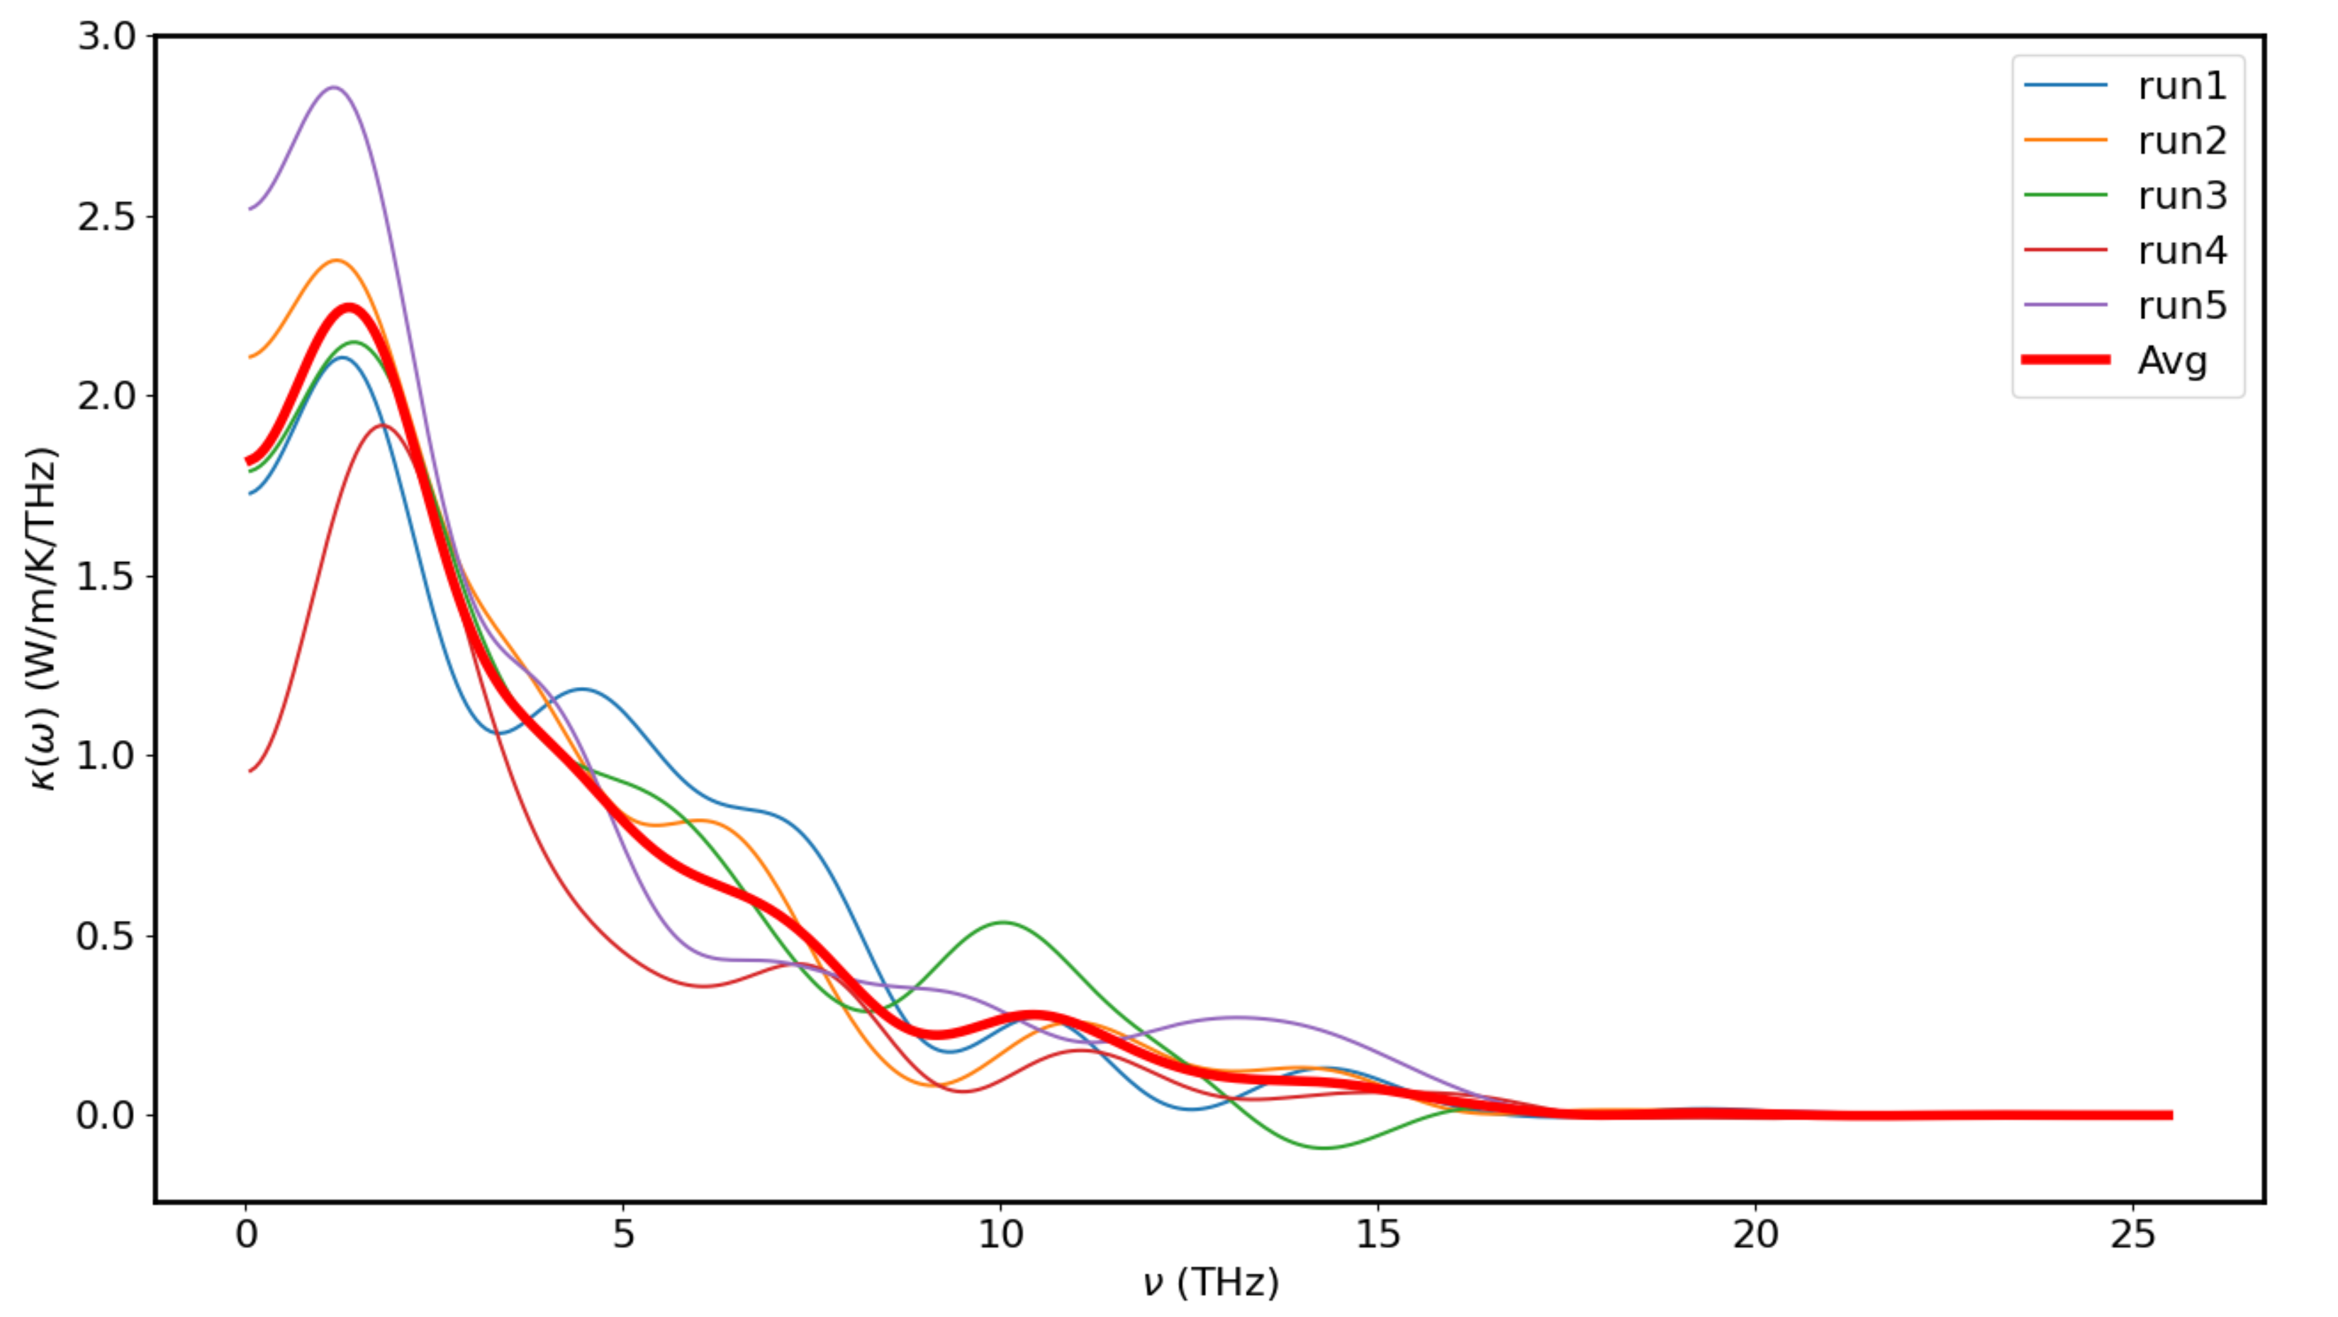
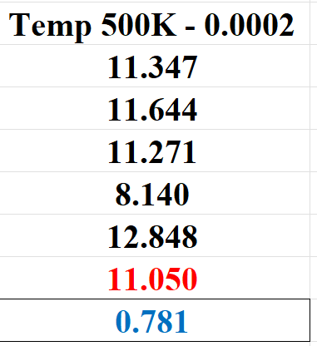
CoNiO - 500K – 0.0002

Slide 43

Paper References

